Slide 1
Chapter 8
Risk and Return

Slide 2
Risk and Return Fundamentals
In most important business decisions there are two key financial considerations: risk and return.
Each financial decision presents certain risk and return characteristics, and the combination of these characteristics can increase or decrease a firm’s share price.
Analysts use different methods to quantify risk depending on whether they are looking at a single asset or a portfolio—a collection, or group, of assets.

Slide 3
Risk and Return Fundamentals: Risk Defined
Risk is a measure of the uncertainty surrounding the return that an investment will earn or, more formally, the variability of returns associated with a given asset.
Return is the total gain or loss experienced on an investment over a given period of time; calculated by dividing the asset’s cash distributions during the period, plus change in value, by its beginning-of-period investment value.

Slide 4
Risk and Return Fundamentals: Risk Defined (cont.)
The expression for calculating the total rate of return earned on any asset over period t, r_{t}, is commonly defined as
where
r_{t} | = | actual, expected, or required rate of return during period t
C_{t} | = | cash (flow) received from the asset investment in the time period t – 1 to t
P_{t} | = | price (value) of asset at time t
P_{t – 1} | = | price (value) of asset at time t – 1

Slide 5
Risk and Return Fundamentals: Risk Defined (cont.)
At the beginning of the year, Apple stock traded for $90.75 per share, and Wal-Mart was valued at $55.33. During the year, Apple paid no dividends, but Wal-Mart shareholders received dividends of $1.09 per share. At the end of the year, Apple stock was worth $210.73 and Wal-Mart sold for $52.84.
We can calculate the annual rate of return, r, for each stock.
Apple: ($0 + $210.73 – $90.75) ÷ $90.75 = 132.2%
Wal-Mart: ($1.09 + $52.84 – $55.33) ÷ $55.33 = –2.5%

Slide 6
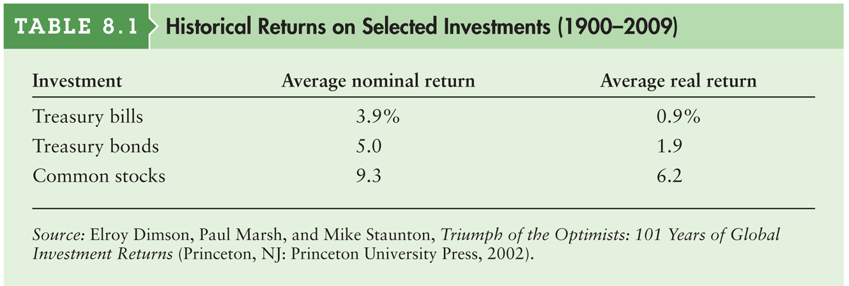
Table 8.1 Historical Returns on Selected Investments (1900–2009)

Slide 7
Risk and Return Fundamentals: Risk Preferences
Economists use three categories to describe how investors respond to risk.
Risk averse is the attitude toward risk in which investors would require an increased return as compensation for an increase in risk.
Risk-neutral is the attitude toward risk in which investors choose the investment with the higher return regardless of its risk.
Risk-seeking is the attitude toward risk in which investors prefer investments with greater risk even if they have lower expected returns.

Slide 8
Risk of a Single Asset: Risk Assessment
Scenario analysis is an approach for assessing risk that uses several possible alternative outcomes (scenarios) to obtain a sense of the variability among returns.
One common method involves considering pessimistic (worst), most likely (expected), and optimistic (best) outcomes and the returns associated with them for a given asset.
Range is a measure of an asset’s risk, which is found by subtracting the return associated with the pessimistic (worst) outcome from the return associated with the optimistic (best) outcome.

Slide 9
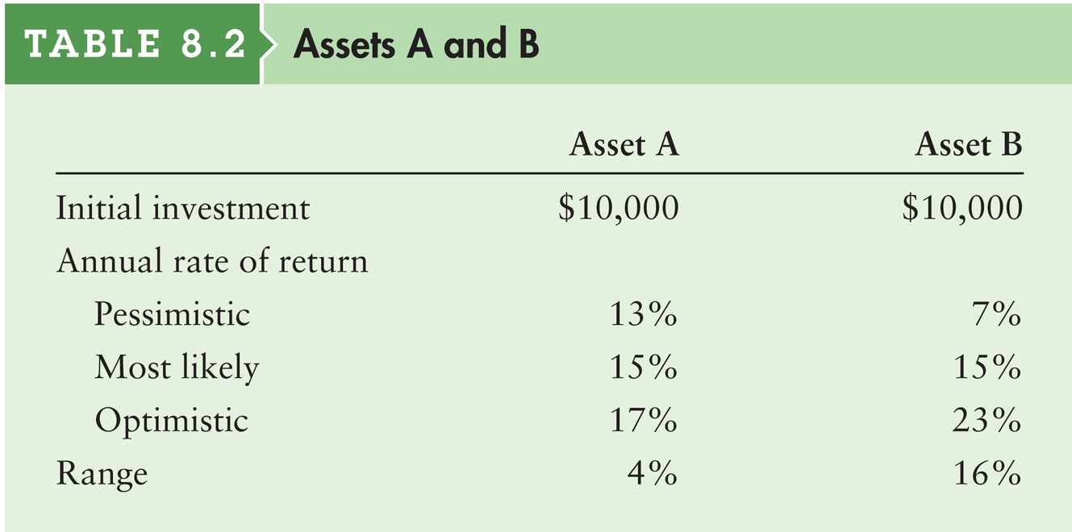
Risk of a Single Asset: Risk Assessment (cont.)
Norman Company wants to choose the better of two investments, A and B. Each requires an initial outlay of $10,000 and each has a most likely annual rate of return of 15%. Management has estimated the returns associated with each investment. Asset A appears to be less risky than asset B. The risk averse decision maker would prefer asset A over asset B, because A offers the same most likely return with a lower range (risk).

Slide 10
Risk of a Single Asset: Risk Assessment
Probability is the chance that a given outcome will occur.
A probability distribution is a model that relates probabilities to the associated outcomes.
A bar chart is the simplest type of probability distribution; shows only a limited number of outcomes and associated probabilities for a given event.
A continuous probability distribution is a probability distribution showing all the possible outcomes and associated probabilities for a given event.

Slide 11
Risk of a Single Asset: Risk Assessment (cont.)
Norman Company’s past estimates indicate that the probabilities of the pessimistic, most likely, and optimistic outcomes are 25%, 50%, and 25%, respectively. Note that the sum of these probabilities must equal 100%; that is, they must be based on all the alternatives considered.

Slide 12
Figure 8.1 Bar charts for asset A’s and asset B’s returns

Slide 13
Figure 8.2 Continuous Probability Distributions

Slide 14
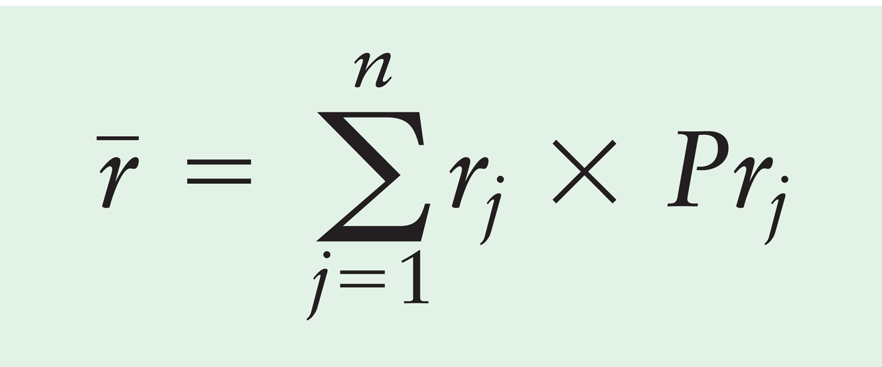
Risk of a Single Asset: Risk Measurement
Standard deviation (σ_{r}) is the most common statistical indicator of an asset’s risk; it measures the dispersion around the expected value.
Expected value of a return (r) is the average return that an investment is expected to produce over time. where
r_{j} | = | return for the j^{th} outcome
Pr_{t} | = | probability of occurrence of the j^{th} outcome
n | = | number of outcomes considered

Slide 15
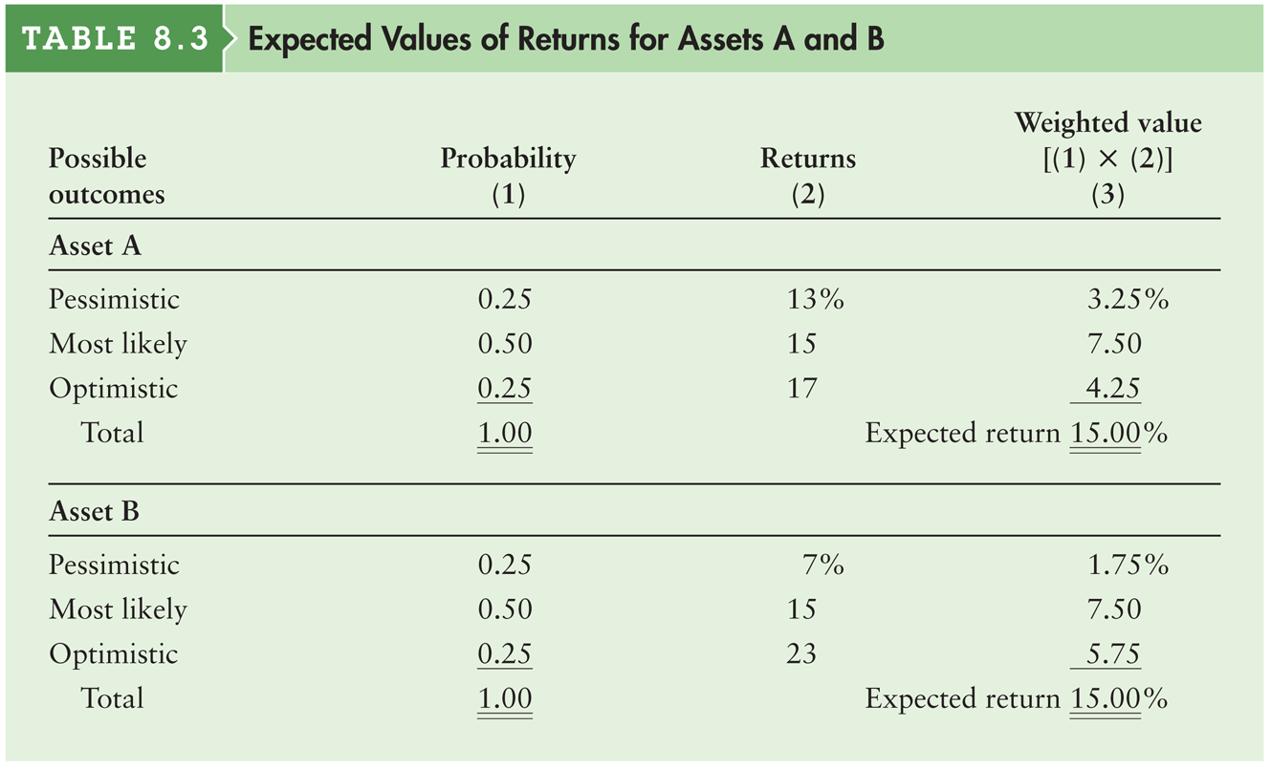
Table 8.3 Expected Values of Returns for Assets A and B

Slide 16
Risk of a Single Asset: Standard Deviation
The expression for the standard deviation of returns, σ_{r}, is
In general, the higher the standard deviation, the greater the risk.

Slide 17
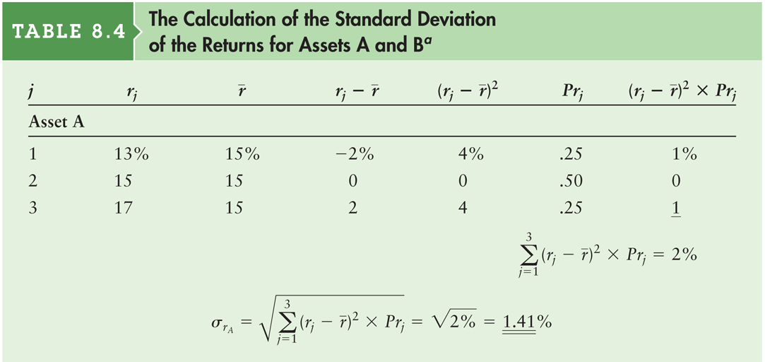
Table 8.4a The Calculation of the Standard Deviation of the Returns for Assets A and B

Slide 18
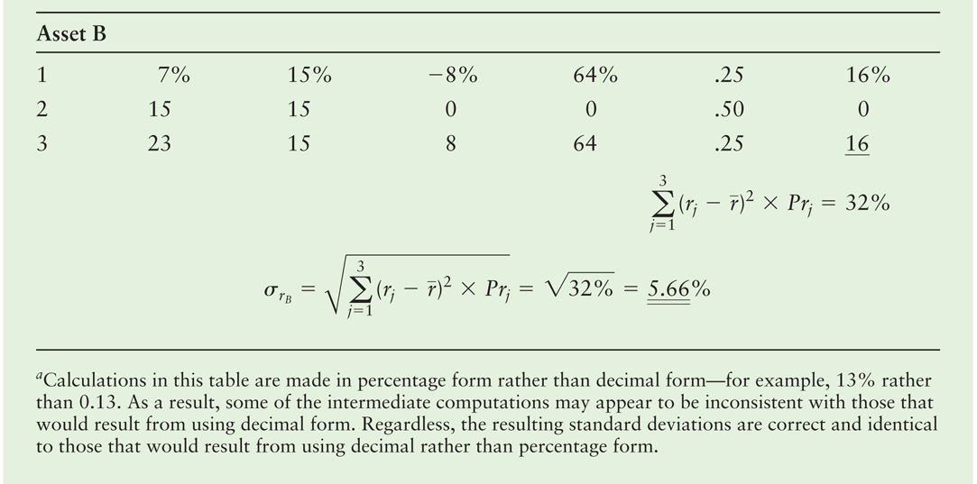
Table 8.4b The Calculation of the Standard Deviation of the Returns for Assets A and B

Slide 19
Table 8.5 Historical Returns and Standard Deviations on Selected Investments (1900–2009)

Slide 20
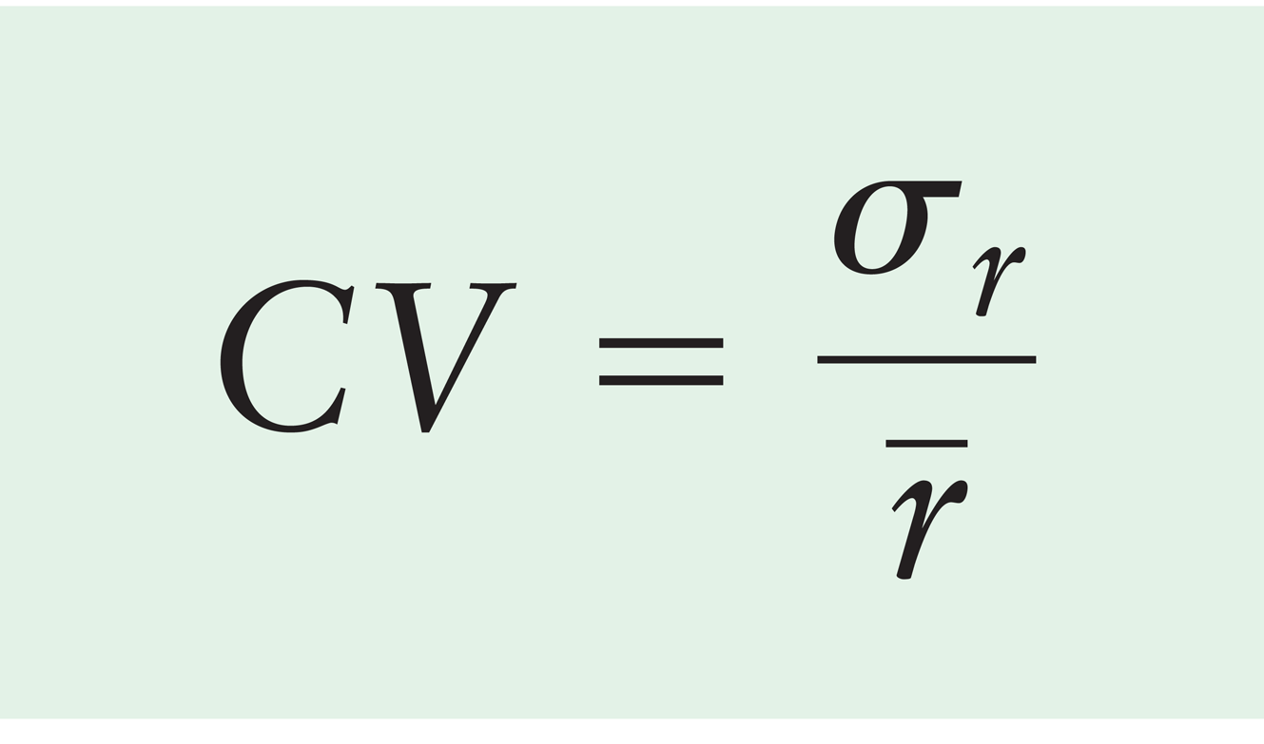
Risk of a Single Asset: Coefficient of Variation
The coefficient of variation, CV, is a measure of relative dispersion that is useful in comparing the risks of assets with differing expected returns.
A higher coefficient of variation means that an investment has more volatility relative to its expected return.

Slide 21
Risk of a Single Asset: Coefficient of Variation (cont.)
Using the standard deviations (from Table 8.4) and the expected returns (from Table 8.3) for assets A and B to calculate the coefficients of variation yields the following:
CV_{A} = 1.41% ÷ 15% = 0.094
CV_{B} = 5.66% ÷ 15% = 0.377

Slide 22
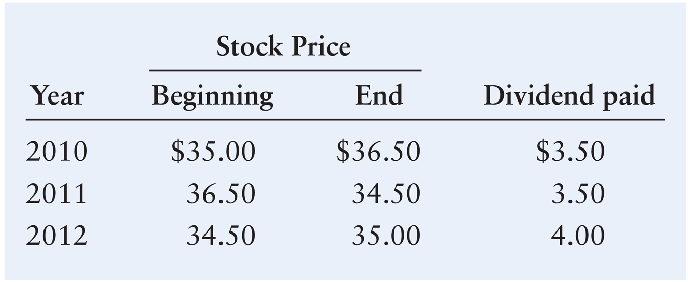
Personal Finance Example

Slide 23
Personal Finance Example (cont.)
Assuming that the returns are equally probable:

Slide 24
Risk of a Portfolio
In real-world situations, the risk of any single investment would not be viewed independently of other assets.
New investments must be considered in light of their impact on the risk and return of an investor’s portfolio of assets.
The financial manager’s goal is to create an efficient portfolio, a portfolio that maximum return for a given level of risk.

Slide 25
Risk of a Portfolio: Portfolio Return and Standard Deviation
The return on a portfolio is a weighted average of the returns on the individual assets from which it is formed.
where
w_{j} | = | proportion of the portfolio’s total dollar value represented by asset j
r_{j} | = | return on asset j

Slide 26
Risk of a Portfolio: Portfolio Return and Standard Deviation
James purchases 100 shares of Wal-Mart at a price of $55 per share, so his total investment in Wal-Mart is $5,500. He also buys 100 shares of Cisco Systems at $25 per share, so the total investment in Cisco stock is $2,500.
Combining these two holdings, James’ total portfolio is worth $8,000.
Of the total, 68.75% is invested in Wal-Mart ($5,500/$8,000) and 31.25% is invested in Cisco Systems ($2,500/$8,000).
Thus, w₁ = 0.6875, w₂ = 0.3125, and w₁ + w₂ = 1.0.

Slide 27
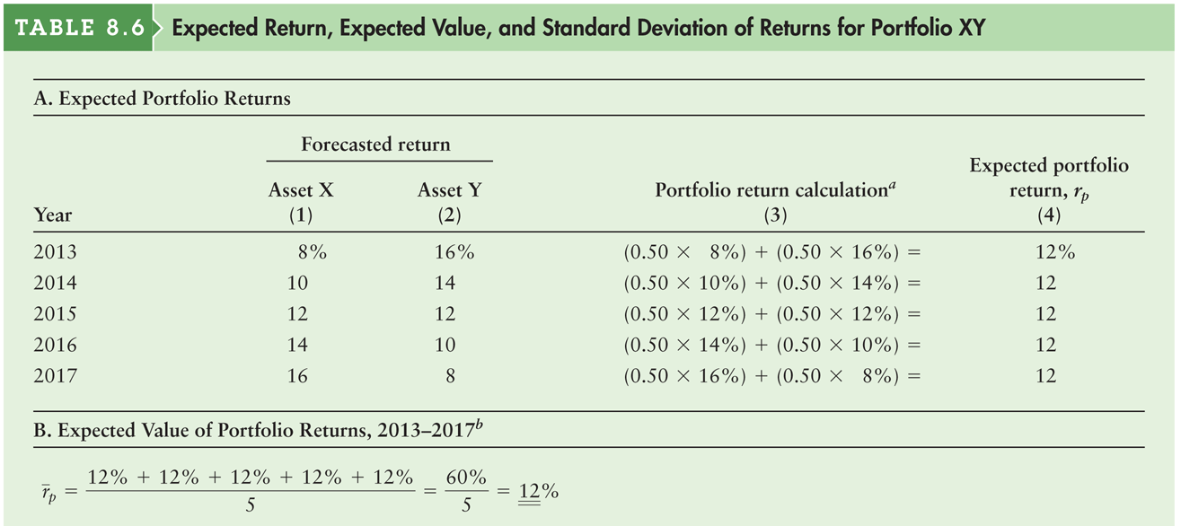
Table 8.6a Expected Return, Expected Value, and Standard Deviation of Returns for Portfolio XY

Slide 28
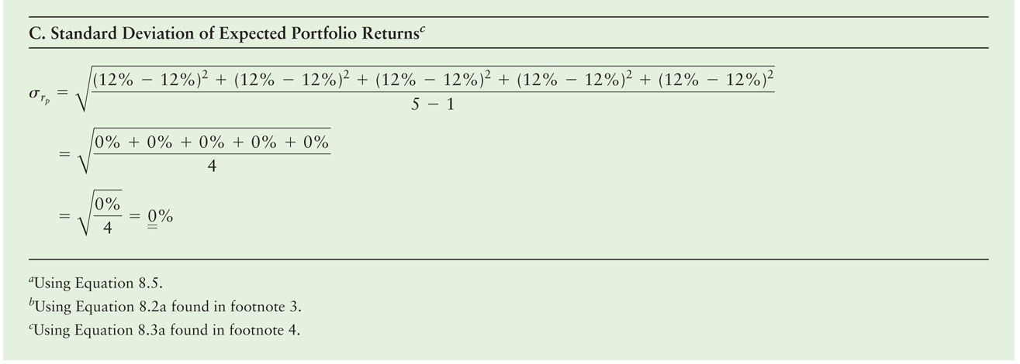
Table 8.6b Expected Return, Expected Value, and Standard Deviation of Returns for Portfolio XY

Slide 29
Risk of a Portfolio: Correlation
Correlation is a statistical measure of the relationship between any two series of numbers.
Positively correlated describes two series that move in the same direction.
Negatively correlated describes two series that move in opposite directions.
The correlation coefficient is a measure of the degree of correlation between two series.
Perfectly positively correlated describes two positively correlated series that have a correlation coefficient of +1.
Perfectly negatively correlated describes two negatively correlated series that have a correlation coefficient of –1.

Slide 30
Figure 8.4 Correlations

Slide 31
Risk of a Portfolio: Diversification
To reduce overall risk, it is best to diversify by combining, or adding to the portfolio, assets that have the lowest possible correlation.
Combining assets that have a low correlation with each other can reduce the overall variability of a portfolio’s returns.
Uncorrelated describes two series that lack any interaction and therefore have a correlation coefficient close to zero.

Slide 32
Figure 8.5 Diversification

Slide 33
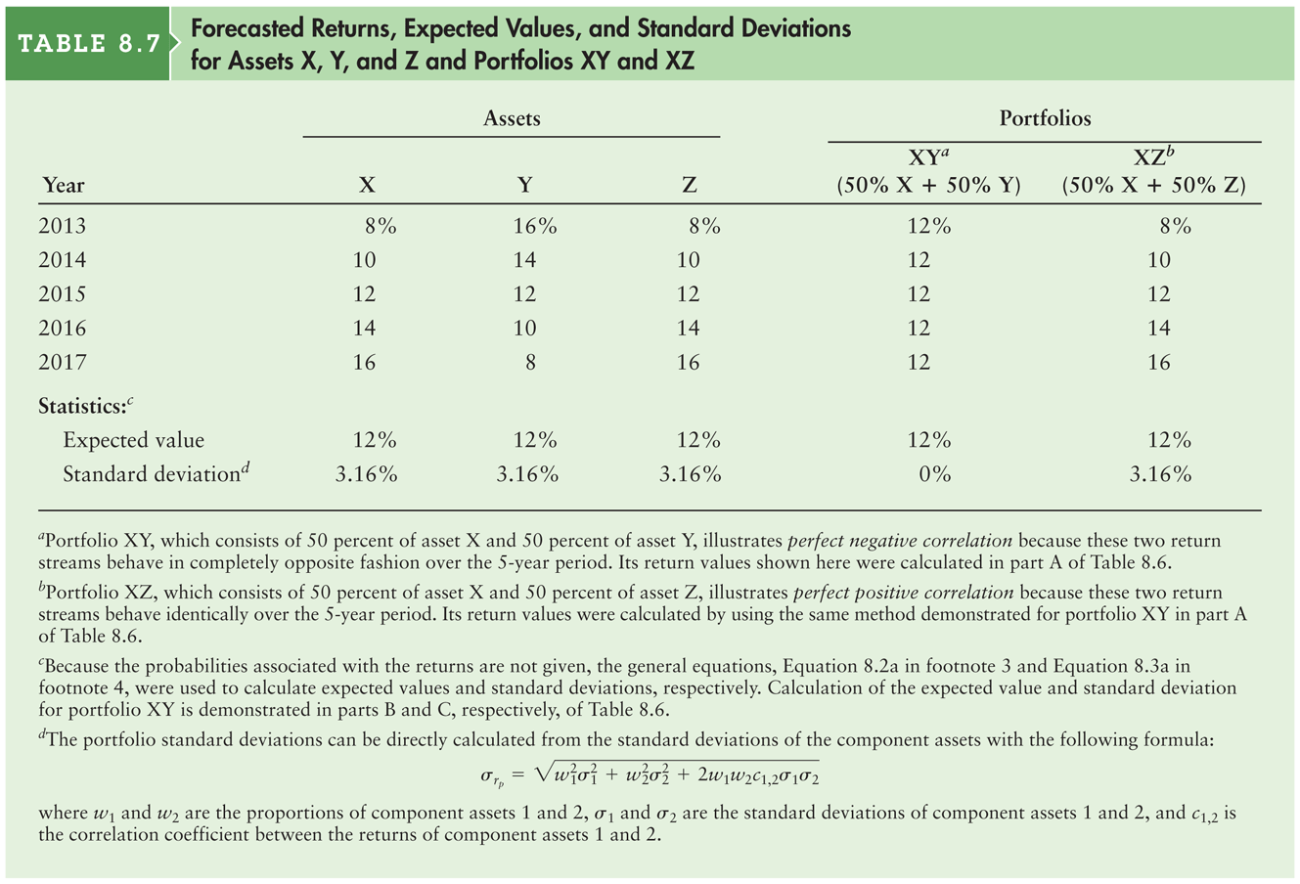
Table 8.7 Forecasted Returns, Expected Values, and Standard Deviations for Assets X, Y, and Z and Portfolios XY and XZ

Slide 34
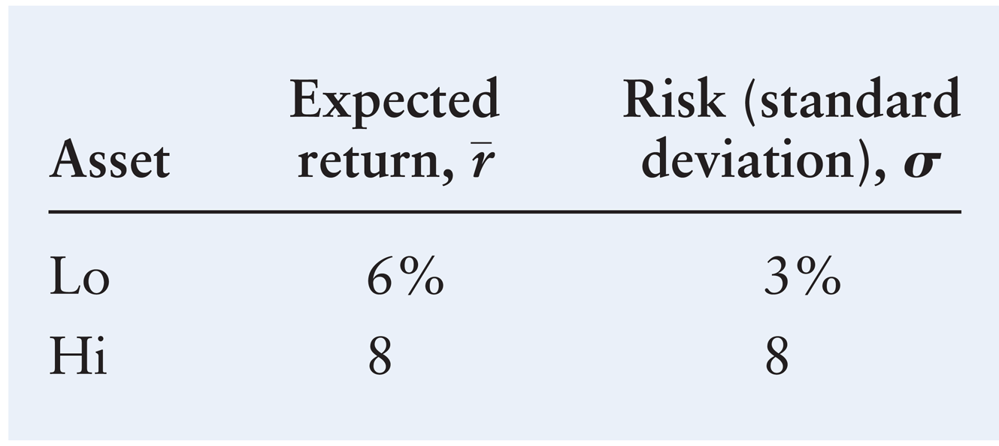
Risk of a Portfolio: Correlation, Diversification, Risk, and Return
Consider two assets—Lo and Hi—with the characteristics described in the table below:

Slide 35
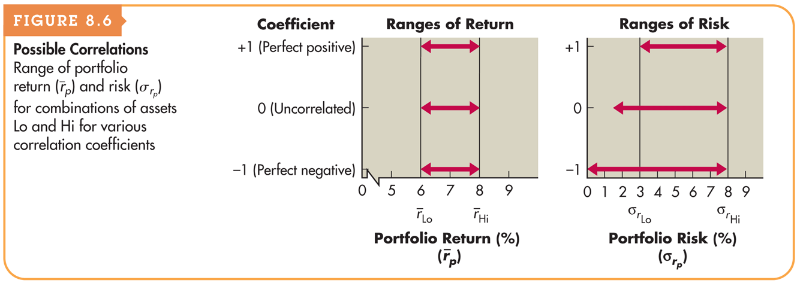
Figure 8.6 Possible Correlations

Slide 36
Risk of a Portfolio: International Diversification
The inclusion of assets from countries with business cycles that are not highly correlated with the U.S. business cycle reduces the portfolio’s responsiveness to market movements.
Over long periods, internationally diversified portfolios tend to perform better (meaning that they earn higher returns relative to the risks taken) than purely domestic portfolios.
However, over shorter periods such as a year or two, internationally diversified portfolios may perform better or worse than domestic portfolios.
Currency risk and political risk are unique to international investing.

Slide 37
Risk and Return: The Capital Asset Pricing Model (CAPM)
The capital asset pricing model (CAPM) is the basic theory that links risk and return for all assets.
The CAPM quantifies the relationship between risk and return.
In other words, it measures how much additional return an investor should expect from taking a little extra risk.

Slide 38
Risk and Return: The CAPM: Types of Risk
Total risk is the combination of a security’s nondiversifiable risk and diversifiable risk.
Diversifiable risk is the portion of an asset’s risk that is attributable to firm-specific, random causes; can be eliminated through diversification. Also called unsystematic risk.
Nondiversifiable risk is the relevant portion of an asset’s risk attributable to market factors that affect all firms; cannot be eliminated through diversification. Also called systematic risk.
Because any investor can create a portfolio of assets that will eliminate virtually all diversifiable risk, the only relevant risk is nondiversifiable risk.

Slide 39
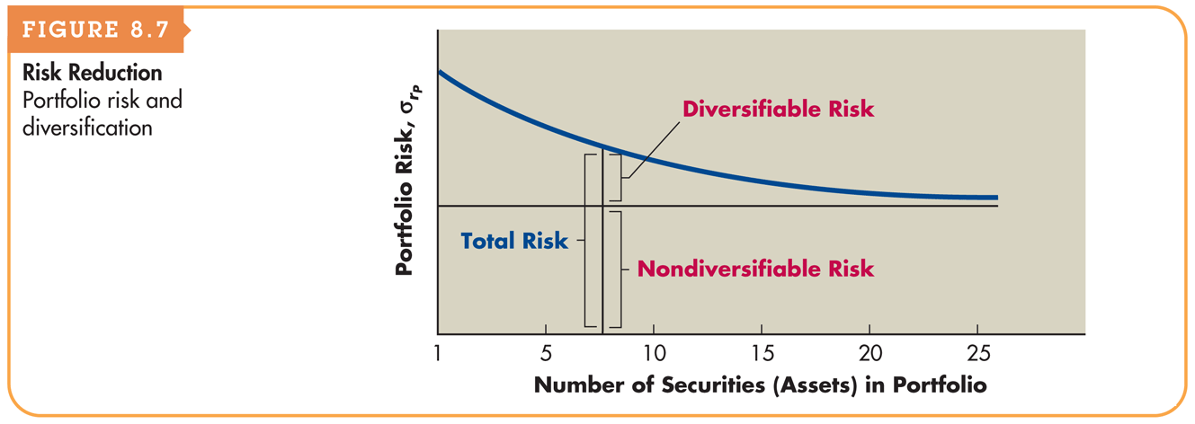
Figure 8.7 Risk Reduction

Slide 40
Risk and Return: The CAPM
The beta coefficient (b) is a relative measure of nondiversifiable risk. An index of the degree of movement of an asset’s return in response to a change in the market return.
An asset’s historical returns are used in finding the asset’s beta coefficient.
The beta coefficient for the entire market equals 1.0. All other betas are viewed in relation to this value.
The market return is the return on the market portfolio of all traded securities.

Slide 41
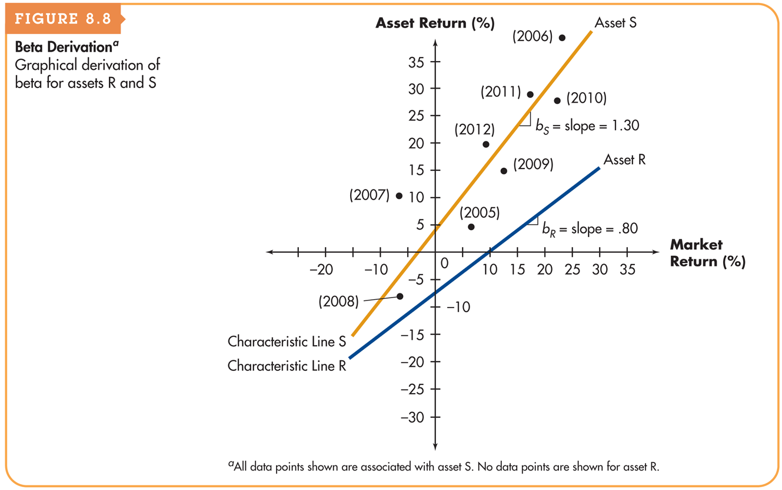
Figure 8.8 Beta Derivation

Slide 42
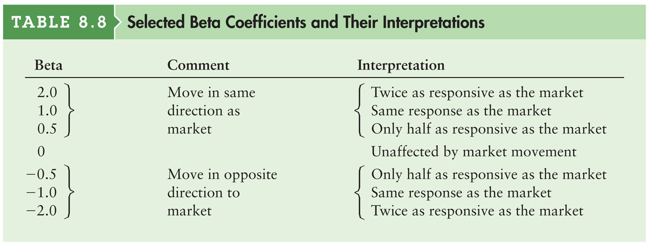
Table 8.8 Selected Beta Coefficients and Their Interpretations

Slide 43
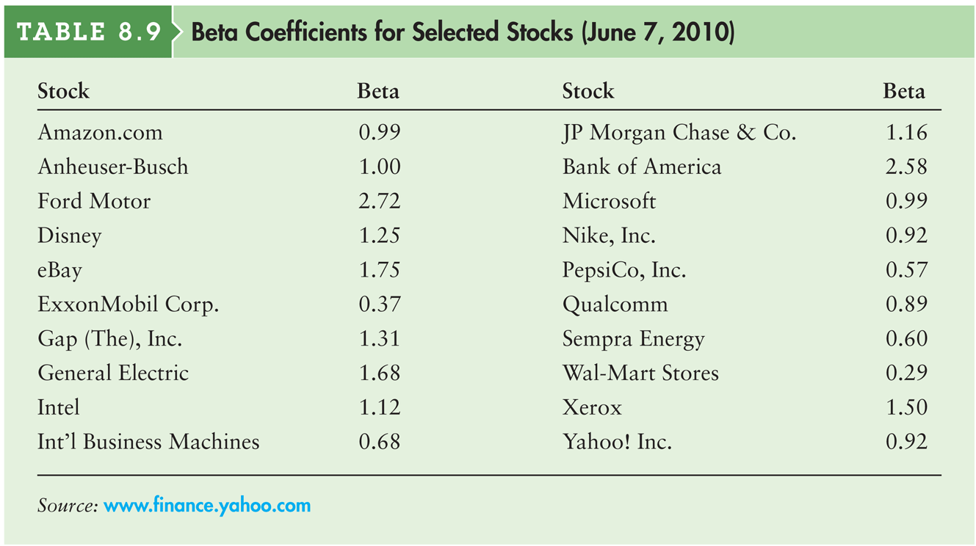
Table 8.9 Beta Coefficients for Selected Stocks (June 7, 2010)

Slide 44
Risk and Return: The CAPM (cont.)
The beta of a portfolio can be estimated by using the betas of the individual assets it includes.
Letting w_{j} represent the proportion of the portfolio’s total dollar value represented by asset j, and letting b_{j} equal the beta of asset j, we can use the following equation to find the portfolio beta, b_{p}:

Slide 45
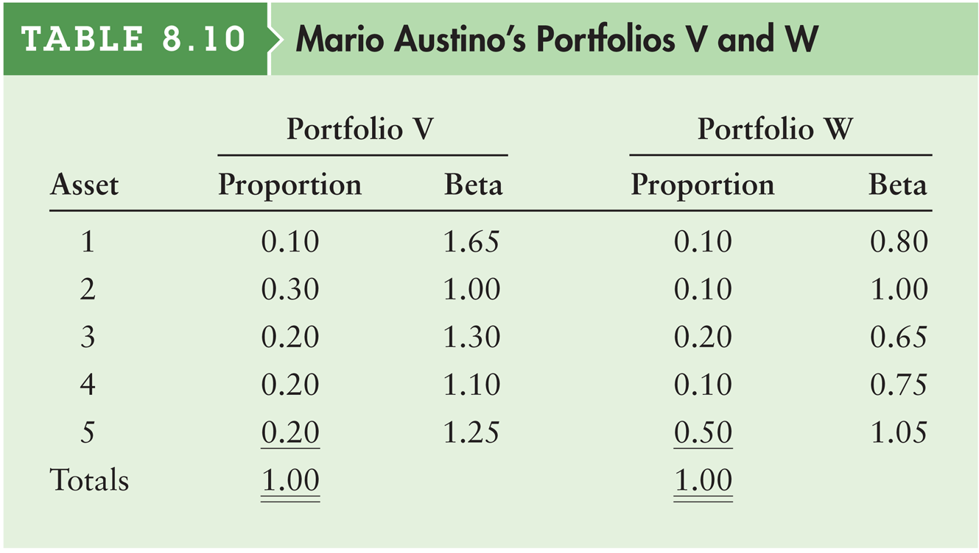
Table 8.10 Mario Austino’s Portfolios V and W

Slide 46
Risk and Return: The CAPM (cont.)
The betas for the two portfolios, b_{v} and b_{w}, can be calculated as follows:
b_{v} | = | (0.10 × 1.65) + (0.30 × 1.00) + (0.20 × 1.30) + (0.20 × 1.10) + (0.20 × 1.25)
 | = | 0.165 + 0.300 +0 .260 + 0.220 + 0.250 = 1.195 ≈ 1.20
b_{w} | = | (0.10 × .80) + (0.10 × 1.00) + (0.20 × .65) + (0.10 × .75) + (0.50 × 1.05)
 | = | 0.080 + 0.100 + 0.130 +0 .075 + 0.525 = 0.91

Slide 47
Risk and Return: The CAPM (cont.)
Using the beta coefficient to measure nondiversifiable risk, the capital asset pricing model (CAPM) is given in the following equation:
r_{j} = R_{F} + [b_{j} × (r_{m} – R_{F})]
where
r_{t} | = | required return on asset j
R_{F} | = | risk-free rate of return, commonly measured by the return on a U.S. Treasury bill
b_{j} | = | beta coefficient or index of nondiversifiable risk for asset j
r_{m} | = | market return; return on the market portfolio of assets

Slide 48
Risk and Return: The CAPM (cont.)
The CAPM can be divided into two parts:
The risk-free rate of return, (R_{F}) which is the required return on a risk-free asset, typically a 3-month U.S. Treasury bill.
The risk premium.
The (r_{m} – R_{F}) portion of the risk premium is called the market risk premium, because it represents the premium the investor must receive for taking the average amount of risk associated with holding the market portfolio of assets.

Slide 49
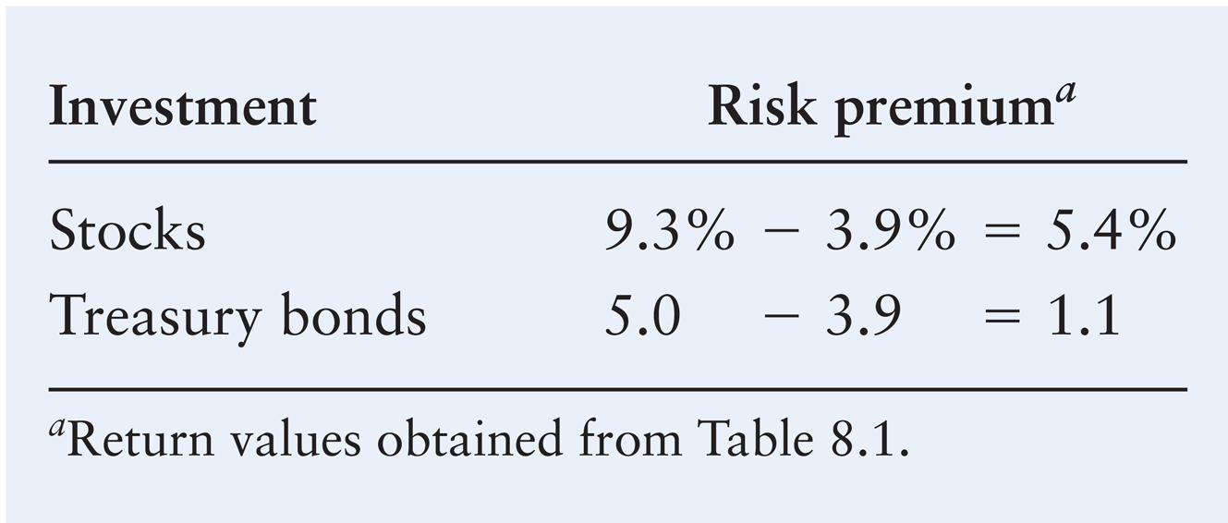
Risk and Return: The CAPM (cont.)
Historical Risk Premium

Slide 50
Risk and Return: The CAPM (cont.)
Benjamin Corporation, a growing computer software developer, wishes to determine the required return on asset Z, which has a beta of 1.5. The risk-free rate of return is 7%; the return on the market portfolio of assets is 11%. Substituting b_{Z} = 1.5, R_{F} = 7%, and r_{m} = 11% into the CAPM yields a return of:
r_{Z} = 7% + [1.5 × (11% – 7%)] = 7% + 6% = 13%

Slide 51
Risk and Return: The CAPM (cont.)
The security market line (SML) is the depiction of the capital asset pricing model (CAPM) as a graph that reflects the required return in the marketplace for each level of nondiversifiable risk (beta).
It reflects the required return in the marketplace for each level of nondiversifiable risk (beta).
In the graph, risk as measured by beta, b, is plotted on the x axis, and required returns, r, are plotted on the y axis.

Slide 52
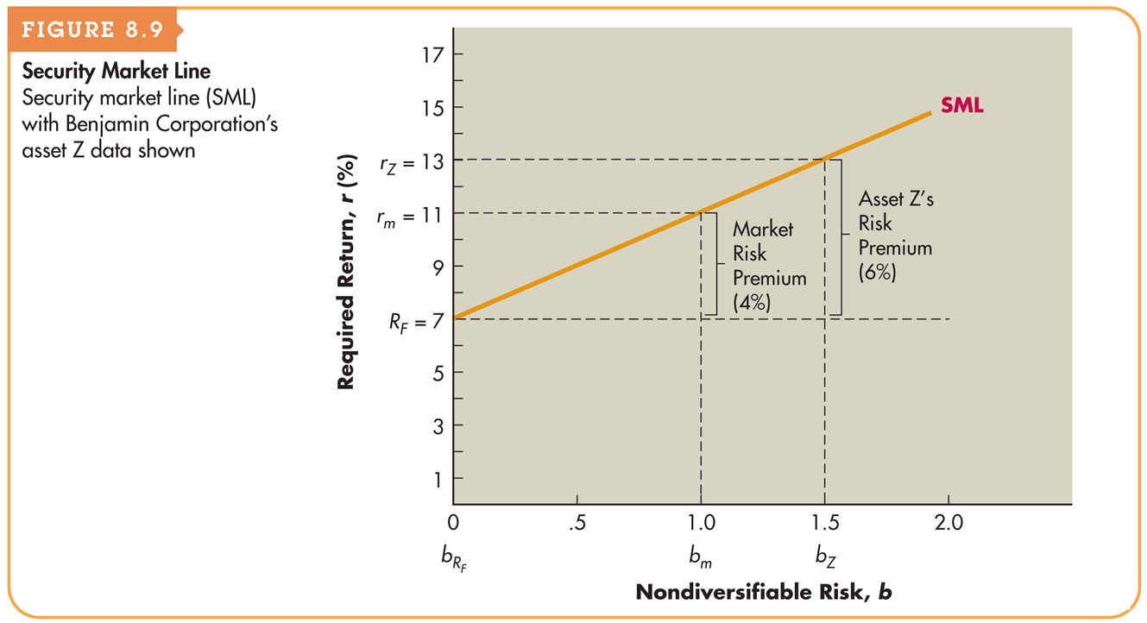
Figure 8.9 Security Market Line

Slide 53
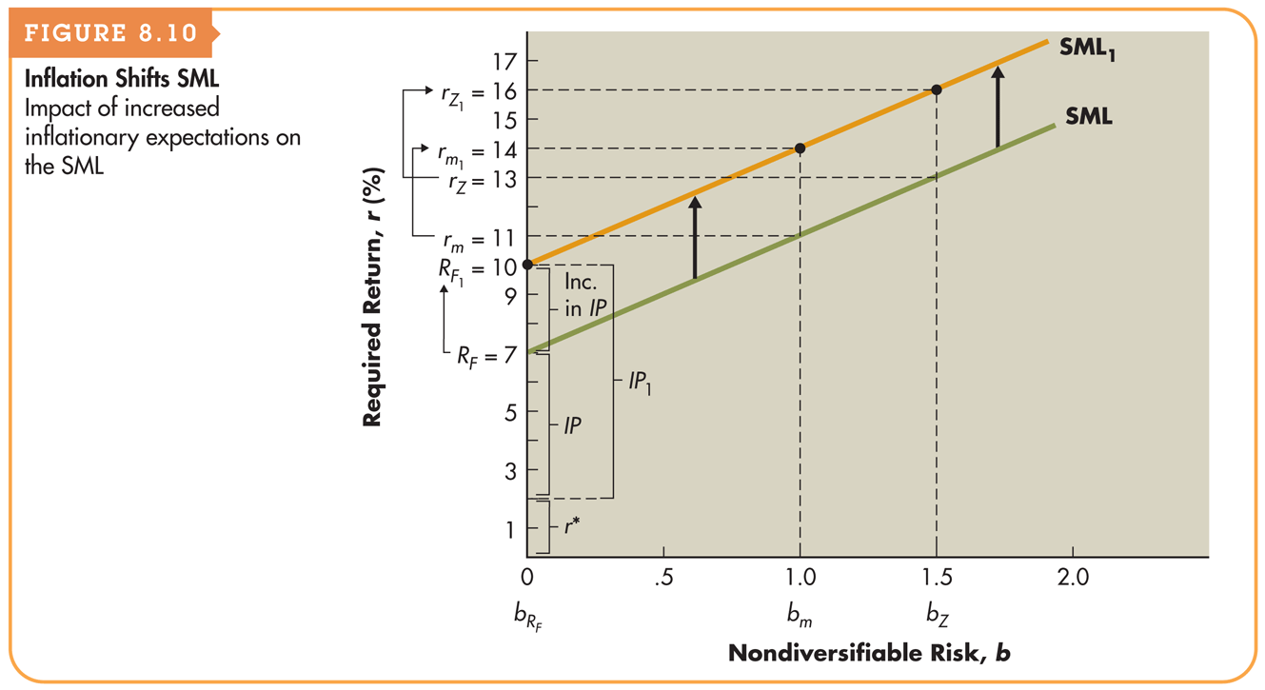
Figure 8.10 Inflation Shifts SML

Slide 54
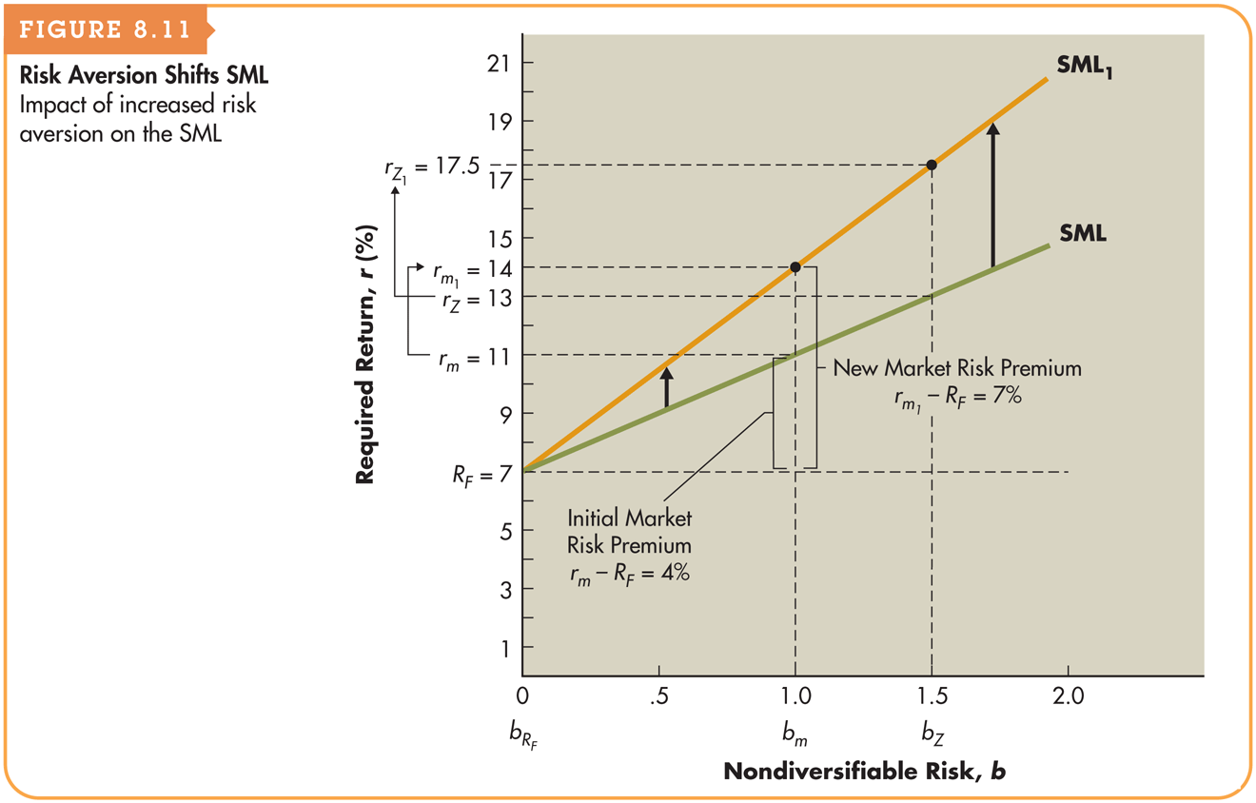
Figure 8.11 Risk Aversion Shifts SML

Slide 55
Risk and Return: The CAPM (cont.)
The CAPM relies on historical data which means the betas may or may not actually reflect the future variability of returns.
Therefore, the required returns specified by the model should be used only as rough approximations.
The CAPM assumes markets are efficient.
Although the perfect world of efficient markets appears to be unrealistic, studies have provided support for the existence of the expectational relationship described by the CAPM in active markets such as the NYSE.

