Slide 1
Interest Rates and Required Returns: Interest Rate Fundamentals
The interest rate is usually applied to debt instruments such as bank loans or bonds; the compensation paid by the borrower of funds to the lender; from the borrower’s point of view, the cost of borrowing funds.
The required return is usually applied to equity instruments such as common stock; the cost of funds obtained by selling an ownership interest.

Slide 2
Interest Rates and Required Returns: Interest Rate Fundamentals
Several factors can influence the equilibrium interest rate:
Inflation, which is a rising trend in the prices of most goods and services.
Risk, which leads investors to expect a higher return on their investment
Liquidity preference, which refers to the general tendency of investors to prefer short-term securities

Slide 3
Interest Rates and Required Returns: The Real Rate of Interest
The real rate of interest is the rate that creates equilibrium between the supply of savings and the demand for investment funds in a perfect world, without inflation, where suppliers and demanders of funds have no liquidity preferences and there is no risk.
The real rate of interest changes with changing economic conditions, tastes, and preferences.
The supply-demand relationship that determines the real rate is shown in Figure 6.1 on the following slide.

Slide 4
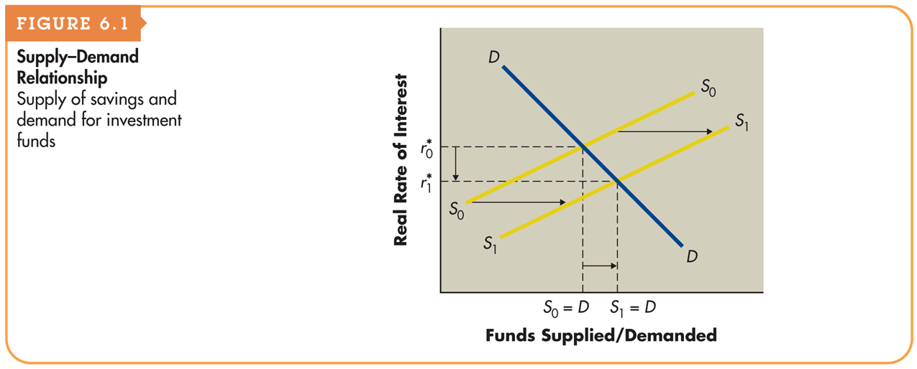
Figure 6.1 Supply–Demand Relationship

Slide 5
Interest Rates and Required Returns: Nominal or Actual Rate of Interest (Return)
The nominal rate of interest is the actual rate of interest charged by the supplier of funds and paid by the demander.
The nominal rate differs from the real rate of interest, r* as a result of two factors:
Inflationary expectations reflected in an inflation premium (IP), and
Issuer and issue characteristics such as default risks and contractual provisions as reflected in a risk premium (RP).

Slide 6
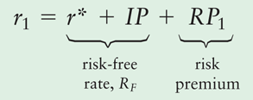
Interest Rates and Required Returns: Nominal or Actual Rate of Interest (cont.)
The nominal rate of interest for security 1, r₁, is given by the following equation:
The nominal rate can be viewed as having two basic components: a risk-free rate of return, R_{F}, and a risk premium, RP₁:
r₁ = RF + RP₁

Slide 7
Interest Rates and Required Returns: Nominal or Actual Rate of Interest (cont.)
For the moment, ignore the risk premium, RP₁, and focus exclusively on the risk-free rate. The risk free rate can be represented as:
R_{F} = r* + IP
The risk-free rate (as shown in the preceding equation) embodies the real rate of interest plus the expected inflation premium.
The inflation premium is driven by investors’ expectations about inflation—the more inflation they expect, the higher will be the inflation premium and the higher will be the nominal interest rate.

Slide 8
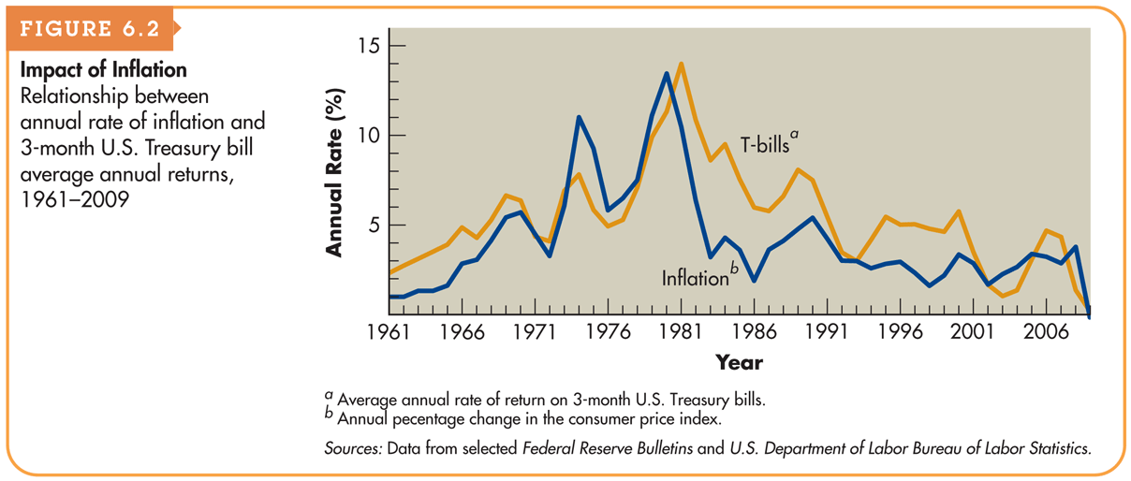
Figure 6.2 Impact of Inflation

Slide 9
Term Structure of Interest Rates
The term structure of interest rates is the relationship between the maturity and rate of return for bonds with similar levels of risk.
A graphic depiction of the term structure of interest rates is called the yield curve.
The yield to maturity is the compound annual rate of return earned on a debt security purchased on a given day and held to maturity.

Slide 10
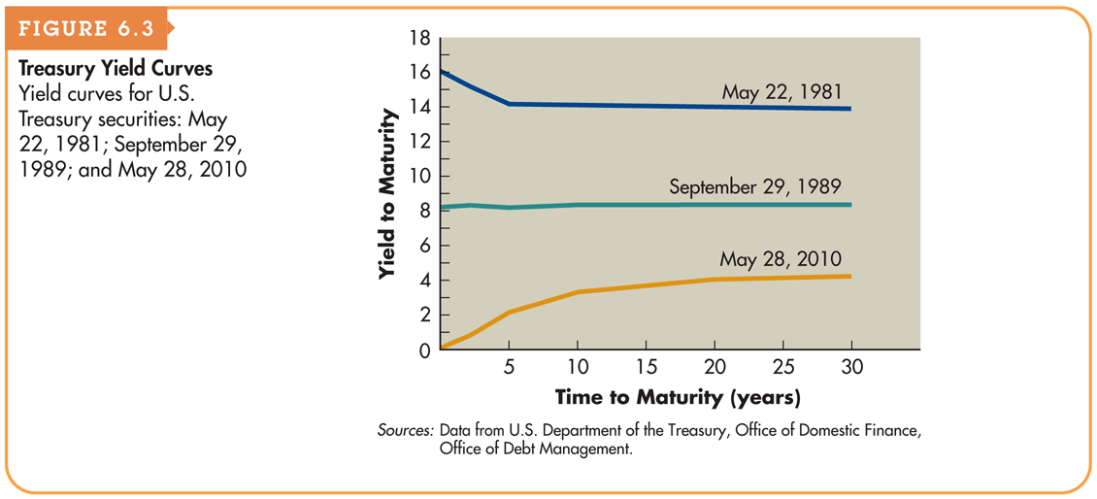
Figure 6.3 Treasury Yield Curves

Slide 11
Term Structure of Interest Rates: Yield Curves (cont.)
A normal yield curve is an upward-sloping yield curve indicates that long-term interest rates are generally higher than short-term interest rates.
An inverted yield curve is a downward-sloping yield curve indicates that short-term interest rates are generally higher than long-term interest rates.
A flat yield curve is a yield curve that indicates that interest rates do not vary much at different maturities.

Slide 12
Term Structure of Interest Rates: Theories of Term Structure
Expectations Theory
Expectations theory is the theory that the yield curve reflects investor expectations about future interest rates; an expectation of rising interest rates results in an upward-sloping yield curve, and an expectation of declining rates results in a downward-sloping yield curve.

Slide 13
Term Structure of Interest Rates: Theories of Term Structure (cont.)
Expectations Theory (example)
Suppose that a 5-year Treasury note currently offers a 3% annual return. Investors believe that interest rates are going to decline, and 5 years from now, they expect the rate on a 5-year Treasury note to be 2.5%. According to the expectations theory, what is the return that a 10-year Treasury note has to offer today? What does this imply about the slope of the yield curve?

Slide 14
Term Structure of Interest Rates: Theories of Term Structure (cont.)
Expectations Theory (example)
Consider an investor who purchases a 5-year note today and plans to reinvest in another 5-year note in the future. Over the 10-year investment horizon, this investor expects to earn about 27.5%, ignoring compounding (that’s 3% per year for the first 5 years and 2.5% per year for the next 5 years). To compete with that return, a 10-year bond today could offer 2.75% per year. That is, a bond that pays 2.75% for each of the next 10 years produces the same 27.5% total return that the series of two, 5-year notes is expected to produce. Therefore, the 5-year rate today is 3% and the 10-year rate today is 2.75%, and the yield curve is downward sloping.

Slide 15
Term Structure of Interest Rates: Theories of Term Structure (cont.)
Liquidity Preference Theory
Liquidity preference theory suggests that long-term rates are generally higher than short-term rates (hence, the yield curve is upward sloping) because investors perceive short-term investments to be more liquid and less risky than long-term investments. Borrowers must offer higher rates on long-term bonds to entice investors away from their preferred short-term securities.

Slide 16
Term Structure of Interest Rates: Theories of Term Structure (cont.)
Market Segmentation Theory
Market segmentation theory suggests that the market for loans is segmented on the basis of maturity and that the supply of and demand for loans within each segment determine its prevailing interest rate; the slope of the yield curve is determined by the general relationship between the prevailing rates in each market segment.

Slide 17
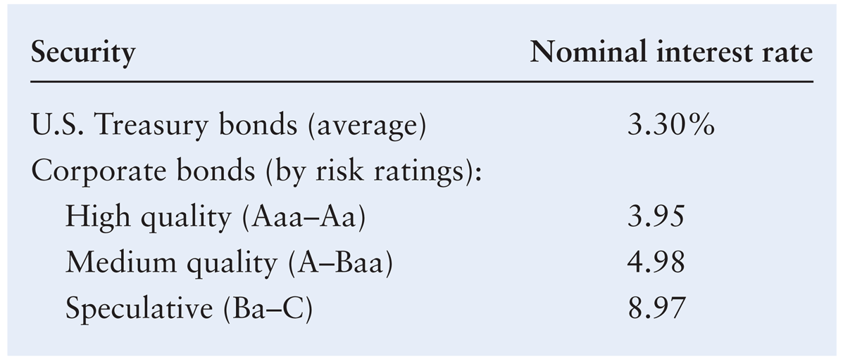
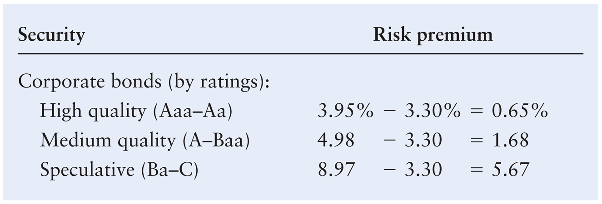
Risk Premiums: Issue and Issuer Characteristics

Slide 18
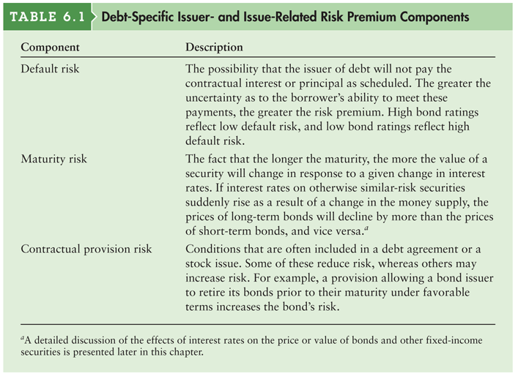
Table 6.1 Debt-Specific Issuer- and Issue-Related Risk Premium Components

Slide 19
Corporate Bonds
A bond is a long-term debt instrument indicating that a corporation has borrowed a certain amount of money and promises to repay it in the future under clearly defined terms.
The bond’s coupon interest rate is the percentage of a bond’s par value that will be paid annually, typically in two equal semiannual payments, as interest.
The bond’s par value, or face value, is the amount borrowed by the company and the amount owed to the bond holder on the maturity date.
The bond’s maturity date is the time at which a bond becomes due and the principal must be repaid.

Slide 20
Corporate Bonds: Legal Aspects of Corporate Bonds
The bond indenture is a legal document that specifies both the rights of the bondholders and the duties of the issuing corporation.
Standard debt provisions are provisions in a bond indenture specifying certain record-keeping and general business practices that the bond issuer must follow; normally, they do not place a burden on a financially sound business.
Restrictive covenants are provisions in a bond indenture that place operating and financial constraints on the borrower.

Slide 21
Corporate Bonds: General Features of a Bond Issue (cont.)
Bonds also are occasionally issued with stock purchase warrants, which are instruments that give their holders the right to purchase a certain number of shares of the issuer’s common stock at a specified price over a certain period of time. Occasionally attached to bonds as “sweeteners.”
Including warrants typically allows the firm to raise debt capital at a lower cost than would be possible in their absence.

Slide 22
Corporate Bonds: Bond Yields
The three most widely cited yields are:
Current yield
Yield to maturity (YTM)
Yield to call (YTC)

Slide 23
Corporate Bonds: Bond Prices
Because most corporate bonds are purchased and held by institutional investors, such as banks, insurance companies, and mutual funds, rather than individual investors, bond trading and price data are not readily available to individuals.
Although most corporate bonds are issued with a par, or face, value of $1,000, all bonds are quoted as a percentage of par.
A $1,000-par-value bond quoted at 94.007 is priced at $940.07 (94.007% × $1,000). Corporate bonds are quoted in dollars and cents. Thus, Company C’s price of 103.143 for the day was $1,031.43—that is, 103.143% × $1,000.

Slide 24
Table 6.2 Data on Selected Bonds

Slide 25
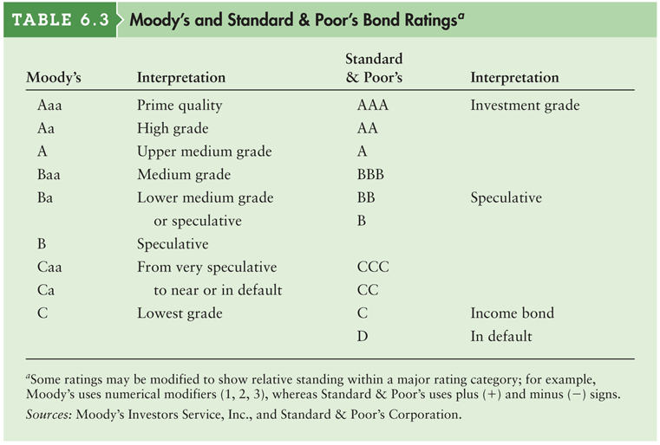
Table 6.3 Moody’s and Standard & Poor’s Bond Ratings

Slide 26
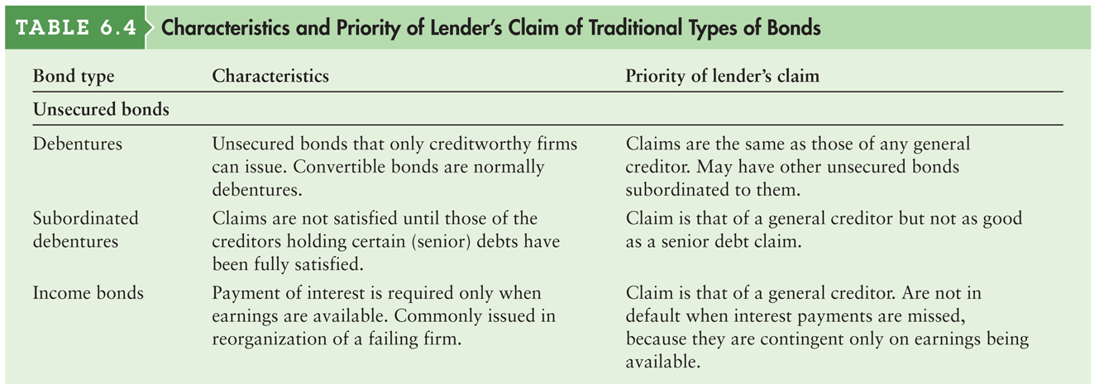
Table 6.4a Characteristics and Priority of Lender’s Claim of Traditional Types of Bonds

Slide 27
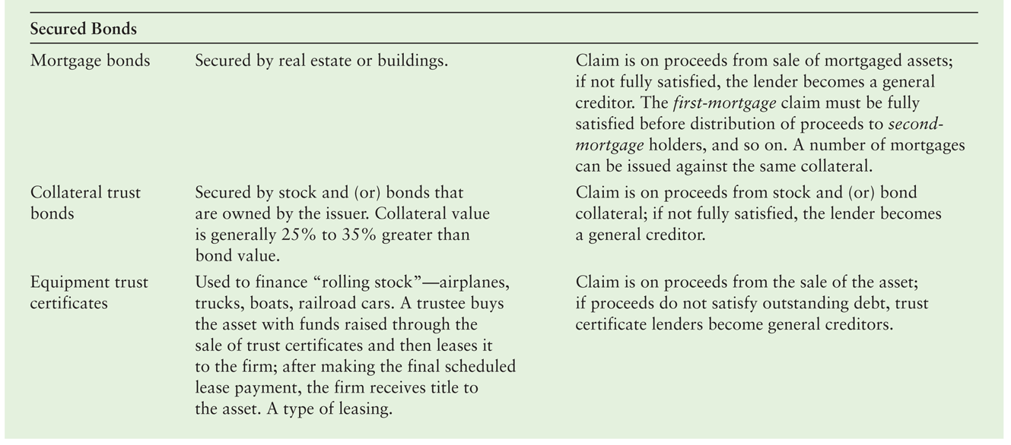
Table 6.4b Characteristics and Priority of Lender’s Claim of Traditional Types of Bonds

Slide 28
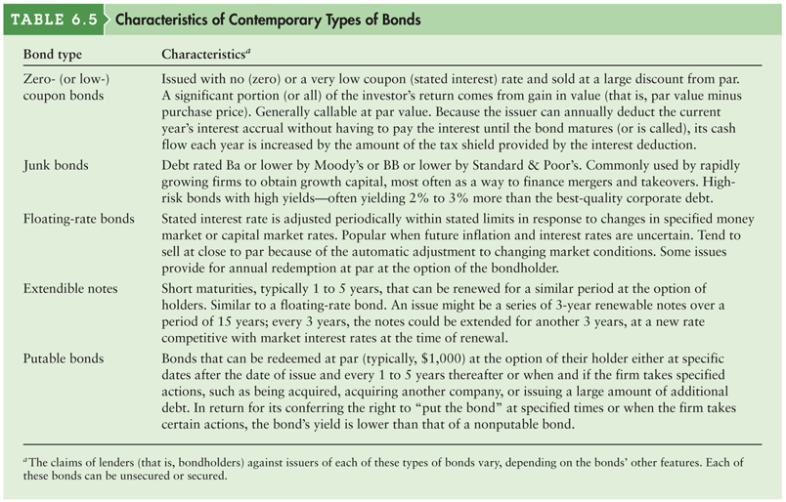
Table 6.5 Characteristics of Contemporary Types of Bonds

Slide 29
Corporate Bonds: International Bond Issues
Companies and governments borrow internationally by issuing bonds in two principal financial markets:
A Eurobond is a bond issued by an international borrower and sold to investors in countries with currencies other than the currency in which the bond is denominated.
In contrast, a foreign bond is a bond issued in a host country’s financial market, in the host country’s currency, by a foreign borrower.
Both markets give borrowers the opportunity to obtain large amounts of long-term debt financing quickly, in the currency of their choice and with flexible repayment terms.

Slide 30
Valuation Fundamentals
Valuation is the process that links risk and return to determine the worth of an asset.
There are three key inputs to the valuation process:
Cash flows (returns)
Timing
A measure of risk, which determines the required return

Slide 31
Basic Valuation Model
The value of any asset is the present value of all future cash flows it is expected to provide over the relevant time period.
The value of any asset at time zero, V₀, can be expressed as
where
v₀ | = | Value of the asset at time zero
CF_{T} | = | cash flow expected at the end of year t
r | = | appropriate required return (discount rate)
n | = | relevant time period

Slide 32
Bond Valuation: Bond Fundamentals
As noted earlier, bonds are long-term debt instruments used by businesses and government to raise large sums of money, typically from a diverse group of lenders.
Most bonds pay interest semiannually at a stated coupon interest rate, have an initial maturity of 10 to 30 years, and have a par value of $1,000 that must be repaid at maturity.

Slide 33
Bond Valuation: Basic Bond Valuation
The basic model for the value, B₀, of a bond is given by the following equation:
Where
B₀ | = | value of the bond at time zero
I | = | annual interest paid in dollars
n | = | number of years to maturity
M | = | par value in dollars
r_{d} | = | required return on a bond

Slide 34
Bond Valuation: Basic Bond Valuation (cont.)
Mills Company, a large defense contractor, on January 1, 2007, issued a 10% coupon interest rate, 10-year bond with a $1,000 par value that pays interest annually.
Investors who buy this bond receive the contractual right to two cash flows: (1) $100 annual interest (10% coupon interest rate × $1,000 par value) at the end of each year and (2) the $1,000 par value at the end of the tenth year.
Assuming that interest on the Mills Company bond issue is paid annually and that the required return is equal to the bond’s coupon interest rate, I = $100, r_{d} = 10%, M = $1,000, and n = 10 years.

Slide 35
Bond Valuation: Bond Value Behavior
In practice, the value of a bond in the marketplace is rarely equal to its par value.
Whenever the required return on a bond differs from the bond’s coupon interest rate, the bond’s value will differ from its par value.
The required return is likely to differ from the coupon interest rate because either (1) economic conditions have changed, causing a shift in the basic cost of long-term funds, or (2) the firm’s risk has changed.
Increases in the basic cost of long-term funds or in risk will raise the required return; decreases in the cost of funds or in risk will lower the required return.

Slide 36
Table 6.6 Bond Values for Various Required Returns (Mills Company’s 10% Coupon Interest Rate, 10-Year Maturity, $1,000 Par, January 1, 2010, Issue Paying Annual Interest)

Slide 37
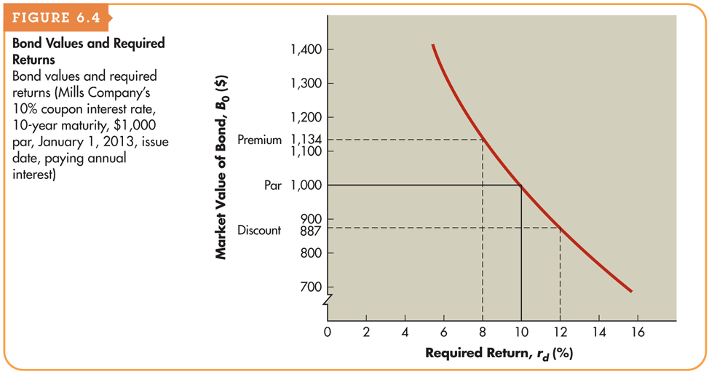
Figure 6.4 Bond Values and Required Returns

Slide 38
Bond Valuation: Bond Value Behavior (cont.)
Interest rate risk is the chance that interest rates will change and thereby change the required return and bond value.
Rising rates, which result in decreasing bond values, are of greatest concern.
The shorter the amount of time until a bond’s maturity, the less responsive is its market value to a given change in the required return.

Slide 39
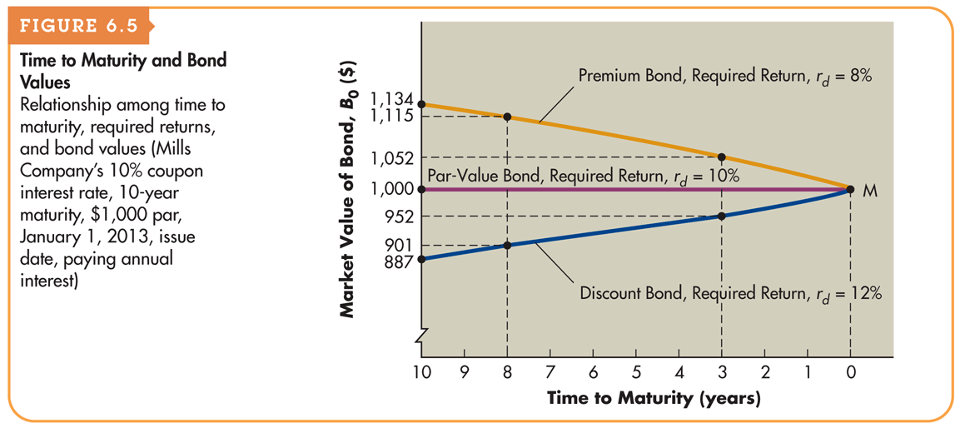
Figure 6.5 Time to Maturity and Bond Values

Slide 40
Yield to Maturity (YTM)
The yield to maturity (YTM) is the rate of return that investors earn if they buy a bond at a specific price and hold it until maturity. (Assumes that the issuer makes all scheduled interest and principal payments as promised.)
The yield to maturity on a bond with a current price equal to its par value will always equal the coupon interest rate.
When the bond value differs from par, the yield to maturity will differ from the coupon interest rate.

Slide 41
Yield to Maturity (YTM): Semiannual Interest and Bond Values
The procedure used to value bonds paying interest semiannually is similar to that shown in Chapter 5 for compounding interest more frequently than annually, except that here we need to find present value instead of future value. It involves
Converting annual interest, I, to semiannual interest by dividing I by 2.
Converting the number of years to maturity, n, to the number of 6-month periods to maturity by multiplying n by 2.
Converting the required stated (rather than effective) annual return for similar-risk bonds that also pay semiannual interest from an annual rate, r_{d}, to a semiannual rate by dividing r_{d} by 2.

Slide 42
Yield to Maturity (YTM): Semiannual Interest and Bond Values (cont.)
Assuming that the Mills Company bond pays interest semiannually and that the required stated annual return, r_{d} is 12% for similar risk bonds that also pay semiannual interest, substituting these values into the previous equation yields

