Slide 1
The Stockholders’ Report
Generally accepted accounting principles (GAAP) are the practice and procedure guidelines used to prepare and maintain financial records and reports; authorized by the Financial Accounting Standards Board (FASB).
The Sarbanes-Oxley Act of 2002, passed to eliminate the many disclosure and conflict of interest problems of corporations, established the Public Company Accounting Oversight Board (PCAOB), which is a not-for-profit corporation that overseas auditors.

Slide 2
The Stockholders’ Report (cont.)
The PCAOB is charged with protecting the interests of investors and furthering the public interest in the preparation of informative, fair, and independent audit reports.
Public corporations with more than $5 million in assets and more than 500 stockholders are required by the Securities and Exchange Commission (SEC) to provide their stockholders with an annual stockholders’ report, which summarizes and documents the firm’s financial activities during the past year.

Slide 3
Global Focus
More Countries Adopt International Financial Reporting Standards
International Financial Reporting Standards (IFRS) are established by the International Accounting Standards Board (IASB).
More than 80 countries now require listed firms to comply with IFRS, and dozens more permit or require firms to follow IFRS to some degree.
In the United States, public companies are required to report financial results using GAAP, which requires more detail than IFRS.
What costs and benefits might be associated with a switch to IFRS in the United States?

Slide 4
The Four Key Financial Statements: The Income Statement
The income statement provides a financial summary of a company’s operating results during a specified period.
Although they are prepared quarterly for reporting purposes, they are generally computed monthly by management and quarterly for tax purposes.

Slide 5
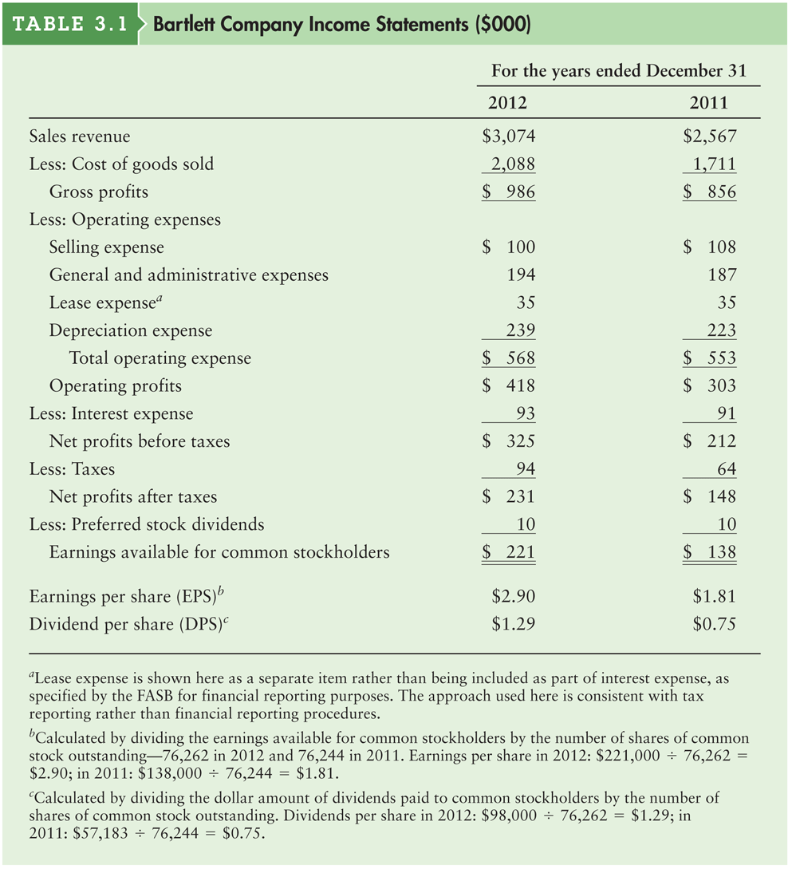
Table 3.1 Bartlett Company Income Statements ($000)

Slide 6
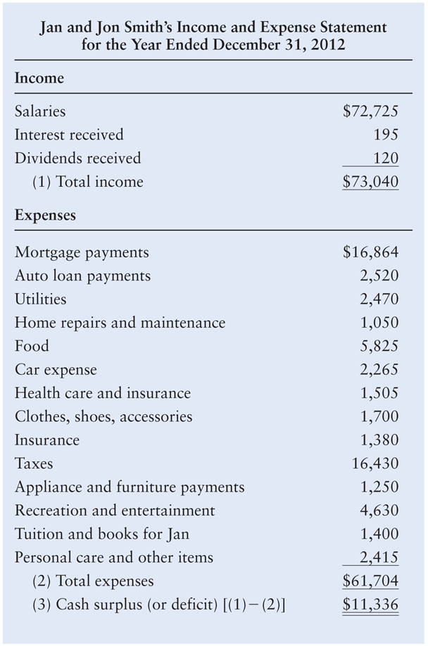
Personal Finance Example

Slide 7
The Four Key Financial Statements: The Balance Sheet
The balance sheet presents a summary of a firm’s financial position at a given point in time.
The statement balances the firm’s assets (what it owns) against its financing, which can be either debt (what it owes) or equity (what was provided by owners).

Slide 8
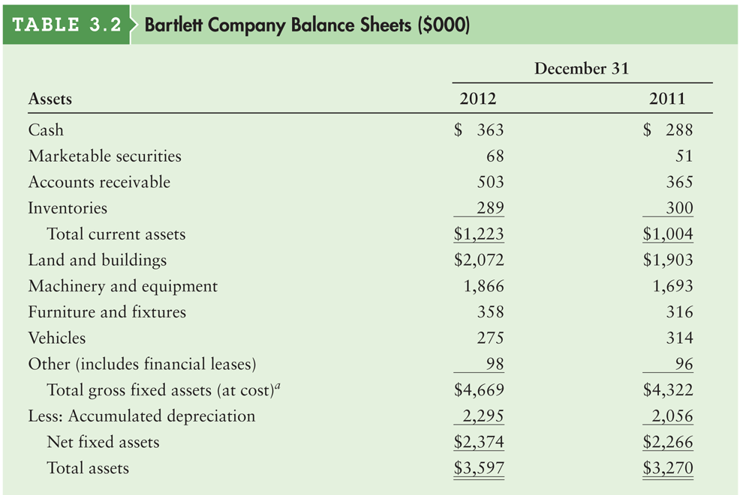
Table 3.2a Bartlett Company Balance Sheets ($000)

Slide 9
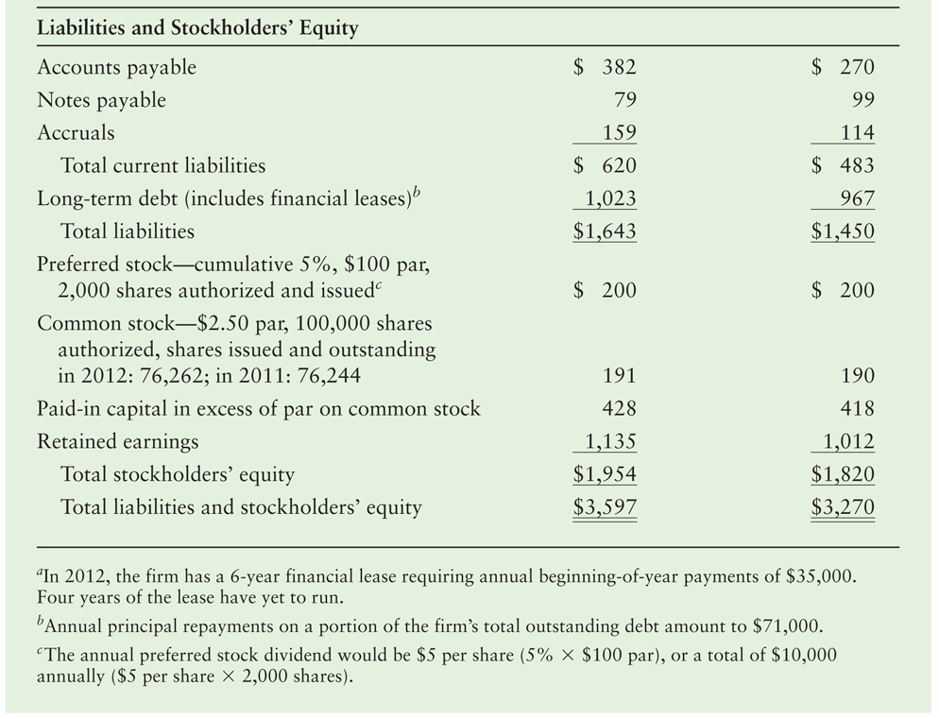
Table 3.2b Bartlett Company Balance Sheets ($000)

Slide 10
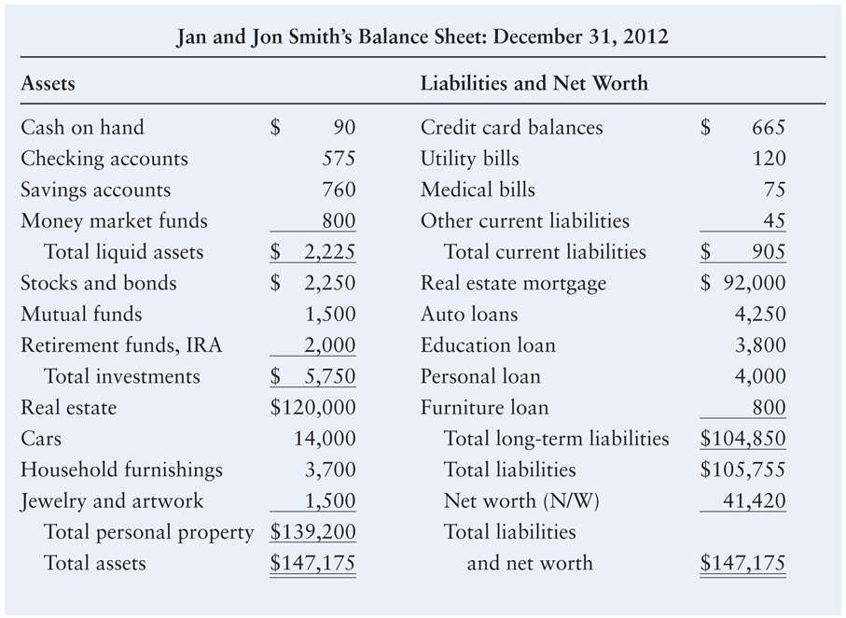
Personal Finance Example

Slide 11
The Four Key Financial Statements: Statement of Retained Earnings
The statement of retained earnings reconciles the net income earned during a given year, and any cash dividends paid, with the change in retained earnings between the start and the end of that year.

Slide 12
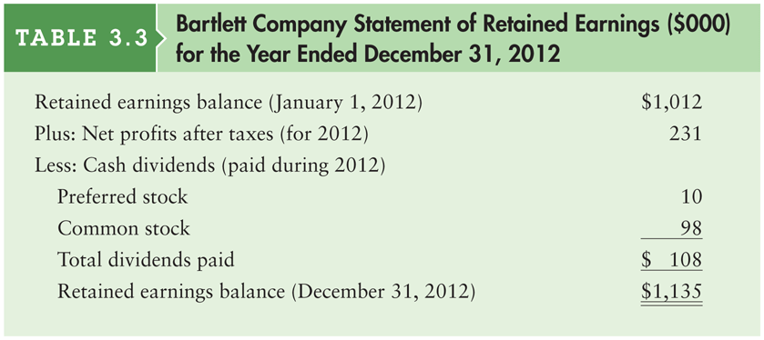
Table 3.3 Bartlett Company Statement of Retained Earnings ($000) for the Year Ended December 31, 2012

Slide 13
The Four Key Financial Statements: Statement of Cash Flows
The statement of cash flows provides a summary of the firm’s operating, investment, and financing cash flows and reconciles them with changes in its cash and marketable securities during the period.
This statement not only provides insight into a company’s investment, financing and operating activities, but also ties together the income statement and previous and current balance sheets.

Slide 14
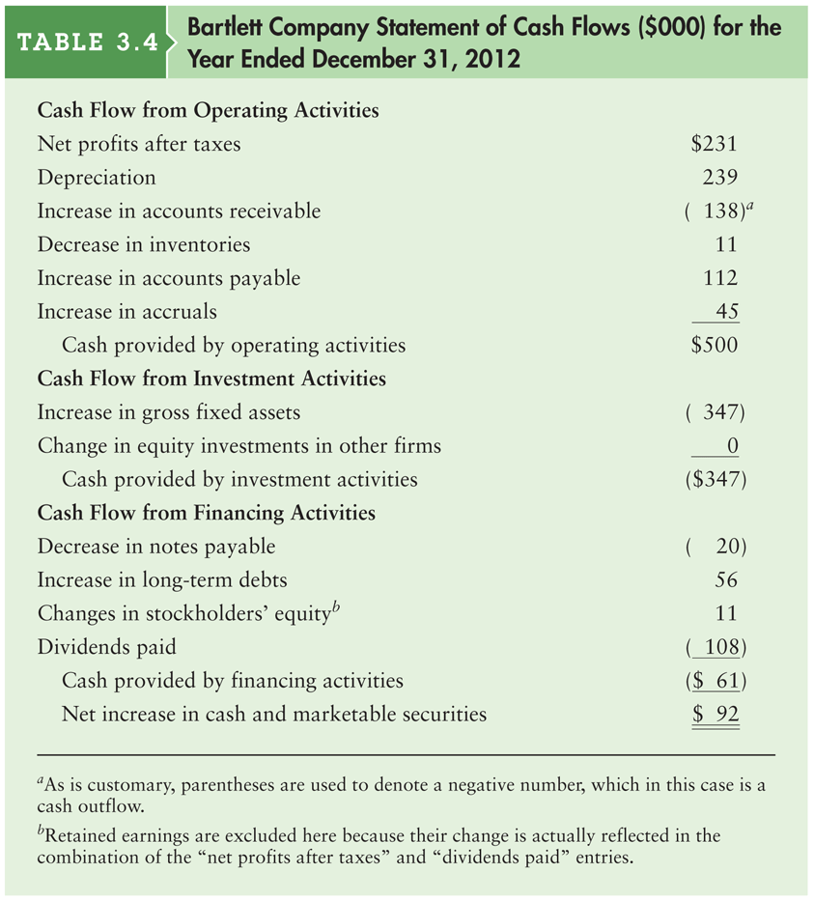
Table 3.4 Bartlett Company Statement of Cash Flows ($000) for the Year Ended December 31, 2012

Slide 15
Using Financial Ratios: Interested Parties
Ratio analysis involves methods of calculating and interpreting financial ratios to analyze and monitor the firm’s performance.
Current and prospective shareholders are interested in the firm’s current and future level of risk and return, which directly affect share price.
Creditors are interested in the short-term liquidity of the company and its ability to make interest and principal payments.
Management is concerned with all aspects of the firm’s financial situation, and it attempts to produce financial ratios that will be considered favorable by both owners and creditors.

Slide 16
Using Financial Ratios: Types of Ratio Comparisons
Cross-sectional analysis is the comparison of different firms’ financial ratios at the same point in time; involves comparing the firm’s ratios to those of other firms in its industry or to industry averages
Benchmarking is a type of cross-sectional analysis in which the firm’s ratio values are compared to those of a key competitor or group of competitors that it wishes to emulate.
Comparison to industry averages is also popular, as in the following example.

Slide 17
Using Financial Ratios: Types of Ratio Comparisons (cont.)
Caldwell Manufacturing’s calculated inventory turnover for 2012 and the average inventory turnover were as follows:
Inventory turnover, 2012
Caldwell Manufacturing 14.8
Industry average 9.7

Slide 18
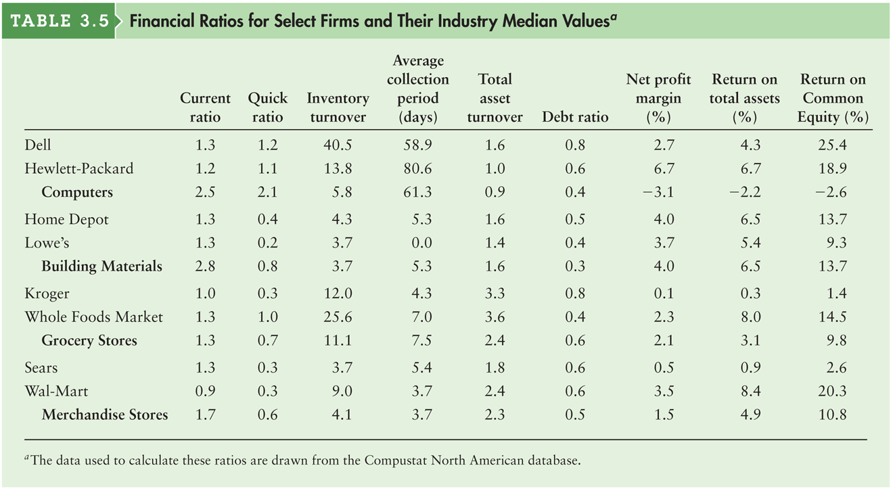
Table 3.5 Financial Ratios for Select Firms and Their Industry Median Values

Slide 19
Using Financial Ratios: Types of Ratio Comparisons (cont.)
Time-series analysis is the evaluation of the firm’s financial performance over time using financial ratio analysis
Comparison of current to past performance, using ratios, enables analysts to assess the firm’s progress.
Developing trends can be seen by using multiyear comparisons.
The most informative approach to ratio analysis combines cross-sectional and time-series analyses.

Slide 20
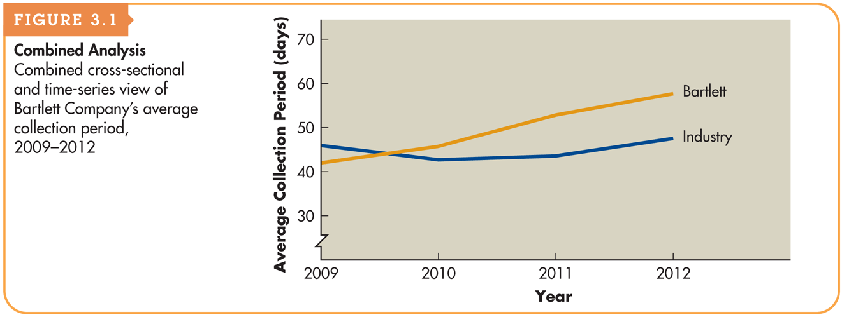
Figure 3.1 Combined Analysis

Slide 21
Using Financial Ratios: Cautions about Using Ratio Analysis
Ratios that reveal large deviations from the norm merely indicate the possibility of a problem.
A single ratio does not generally provide sufficient information from which to judge the overall performance of the firm.
The ratios being compared should be calculated using financial statements dated at the same point in time during the year.
It is preferable to use audited financial statements.
The financial data being compared should have been developed in the same way.
Results can be distorted by inflation.

Slide 22
Ratio Analysis Example
We will illustrate the use of financial ratios for analyzing financial statements using the Bartlett Company Income Statements and Balance Sheets presented earlier in Tables 3.1 and 3.2.

Slide 23
Ratio Analysis
Liquidity Ratios
Current ratio = Current assets ÷ Current liabilities
The current ratio for Bartlett Company in 2012 is:
$1,223,000 ÷ $620,000 = 1.97

Slide 24
Matter of Fact
Determinants of liquidity needs
Large enterprises generally have well established relationships with banks that can provide lines of credit and other short-term loan products in the event that the firm has a need for liquidity.
Smaller firms may not have the same access to credit, and therefore they tend to operate with more liquidity.

Slide 25
Personal Finance Example
The personal liquidity ratio is calculated by dividing total liquid assets by total current debt. It indicates the percent of annual debt obligations that an individual can meet using current liquid assets.
Calculate Jan and Jon Smith’s liquidity ratio for calendar year 2012:
Liquidity ratio = ($2,225/$21,539) = 0.1033, or 10.3%
That ratio indicates that the Smiths can cover only about 10 percent of their existing 1-year debt obligations with their current liquid assets.

Slide 26
Ratio Analysis (cont.)
Liquidity Ratios
The quick ratio for Bartlett Company in 2012 is:

Slide 27
Matter of Fact
The importance of inventories:
From Table 3.5:
All three firms have current ratios of 1.3. However, the quick ratios for Home Depot and Lowes are dramatically lower than their current ratios, but for Dell the two ratios are nearly the same. Why?
Company | Current ratio | Quick ratio
Dell | 1.3 | 1.2
Home Depot | 1.3 | 0.4
Lowes | 1.3 | 0.2

Slide 28
Ratio Analysis (cont.)
Activity Ratios
Inventory turnover = Cost of goods sold ÷ Inventory Applying this relationship to Bartlett Company in 2012 yields: $2,088,000 ÷ $289,000 = 7.2

Slide 29
Ratio Analysis (cont.)
Activity Ratios
Average Age of Inventory = 365 ÷ Inventory turnover For Bartlett Company, the average age of inventory in 2012 is: 365 ÷ 7.2 = 50.7 days

Slide 30
Ratio Analysis (cont.)
Activity Ratios
The average collection period for Bartlett Company in 2012 is:

Slide 31
Matter of Fact
Who gets credit?
Notice in Table 3.5 the vast differences across industries in the average collection periods.
Companies in the building materials, grocery, and merchandise store industries collect in just a few days, whereas firms in the computer industry take roughly two months to collect on their sales.
The difference is primarily due to the fact that these industries serve very different customers.

Slide 32
Ratio Analysis (cont.)
Activity Ratios
If we assume that Bartlett Company’s purchases equaled 70 percent of its cost of goods sold in 2012, its average payment period is:

Slide 33
Ratio Analysis (cont.)
Activity Ratios
Total asset turnover = Sales ÷ Total assets The value of Bartlett Company’s total asset turnover in 2012 is: $3,074,000 ÷ $3,597,000 = 0.85

Slide 34
Matter of Fact
Sell it fast
Observe in Table 3.5 that the grocery business turns over assets faster than any of the other industries listed.
That makes sense because inventory is among the most valuable assets held by these firms, and grocery stores have to sell baked goods, dairy products, and produce quickly or throw them away when they spoil.
On average, a grocery stores has to replace its entire inventory in just a few days or weeks, and that contributes to the rapid turnover of the firms total assets.

Slide 35
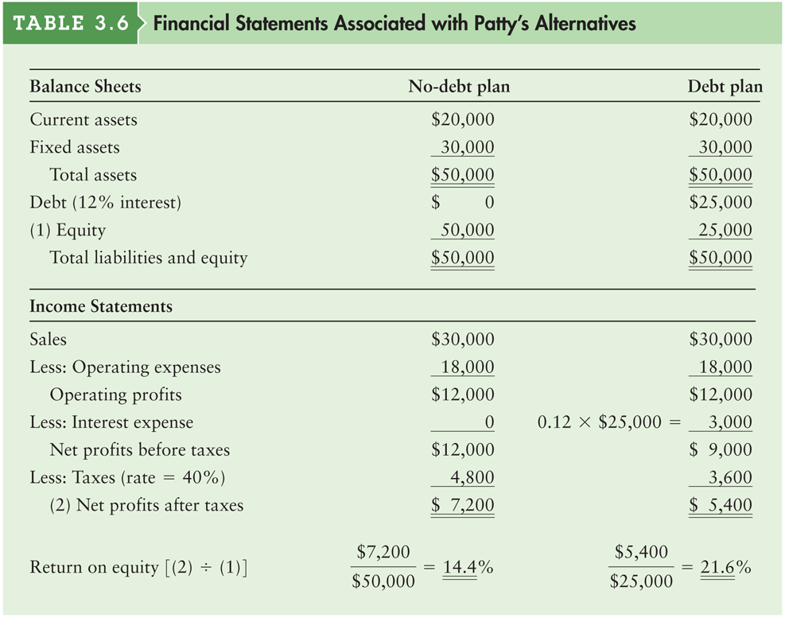
Table 3.6 Financial Statements Associated with Patty’s Alternatives

Slide 36
Ratio Analysis (cont.)
Debt Ratios
Debt ratio = Total liabilities ÷ Total assets The debt ratio for Bartlett Company in 2012 is $1,643,000 ÷ $3,597,000 = 0.457 = 45.7%

Slide 37
Ratio Analysis (cont.)
Debt Ratios
Times interest earned ratio = EBIT ÷ interest The figure for earnings before interest and taxes (EBIT) is the same as that for operating profits shown in the income statement. Applying this ratio to Bartlett Company yields the following 2012 value: $418,000 ÷ $93,000 = 4.5

Slide 38
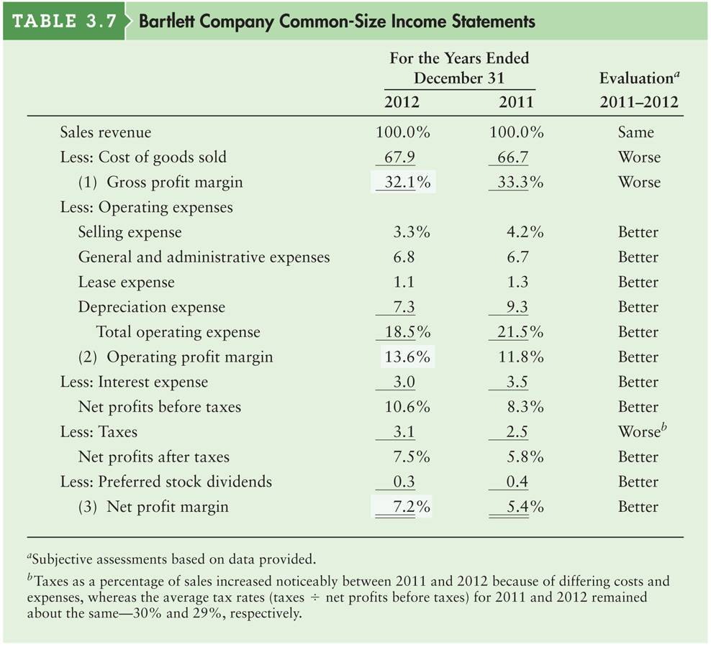
Table 3.7 Bartlett Company Common-Size Income Statements

Slide 39
Ratio Analysis (cont.)
Profitability Ratios
Bartlett Company’s gross profit margin for 2012 is:

Slide 40
Ratio Analysis (cont.)
Profitability Ratios
Operating profit margin = Operating profits ÷ sales Bartlett Company’s operating profit margin for 2012 is: $418,000 ÷ $3,074,000 = 13.6%

Slide 41
Ratio Analysis (cont.)
Profitability Ratios
Net profit margin = Earnings available for common stockholders ÷ Sales Bartlett Company’s net profit margin for 2012 is: $221,000 ÷ $3,074,000 = 0.072 = 7.2%

Slide 42
Ratio Analysis (cont.)
Profitability Ratios
Bartlett Company’s earnings per share (EPS) in 2012 is:
$221,000 ÷ 76,262 = $2.90

Slide 43
Ratio Analysis (cont.)
Profitability Ratios
Return on total assets (ROA) = Earnings available for common stockholders ÷ Total assets Bartlett Company’s return on total assets in 2012 is: $221,000 ÷ $3,597,000 = 0.061 = 6.1%

Slide 44
Ratio Analysis (cont.)
Profitability Ratios
Return on Equity (ROE) = Earnings available for common stockholders ÷ Common stock equity This ratio for Bartlett Company in 2012 is: $221,000 ÷ $1,754,000 = 0.126 = 12.6%

Slide 45
Ratio Analysis (cont.)
Market Ratios
Price Earnings (P/E) Ratio = Market price per share of common stock ÷ Earnings per share If Bartlett Company’s common stock at the end of 2012 was selling at $32.25, using the EPS of $2.90, the P/E ratio at year-end 2012 is: $32.25 ÷ $2.90 = 11.1

Slide 46
Ratio Analysis (cont.)
Market Ratios
where,

Slide 47
Ratio Analysis (cont.)
Substituting the appropriate values for Bartlett Company from its 2012 balance sheet, we get:
Substituting Bartlett Company’s end of 2012 common stock price of $32.25 and its $23.00 book value per share of common stock (calculated above) into the M/B ratio formula, we get: $32.25 ÷ $23.00 = 1.40

Slide 48
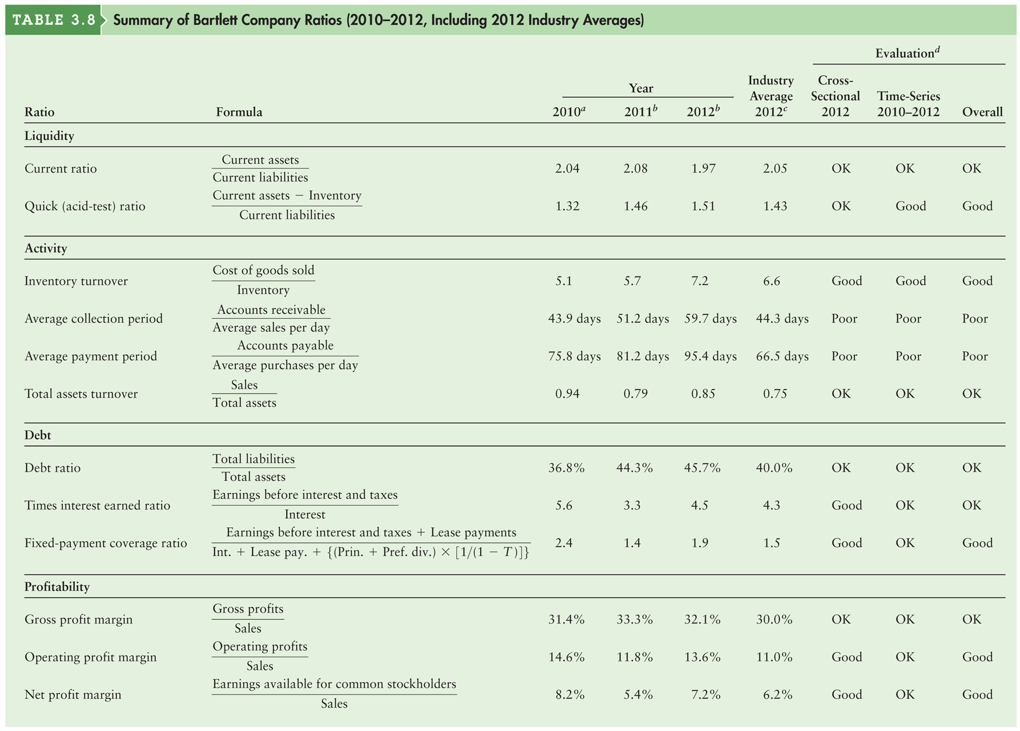
Table 3.8a Summary of Bartlett Company Ratios

Slide 49
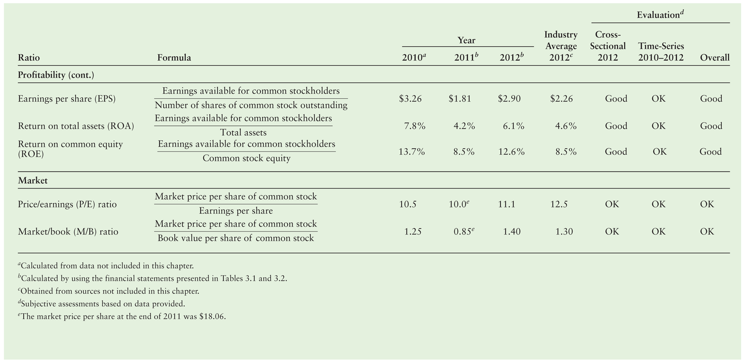
Table 3.8b Summary of Bartlett Company Ratios

Slide 50
DuPont System of Analysis
The DuPont system of analysis is used to dissect the firm’s financial statements and to assess its financial condition.
It merges the income statement and balance sheet into two summary measures of profitability.
The Modified DuPont Formula relates the firm’s ROA to its ROE using the financial leverage multiplier (FLM), which is the ratio of total assets to common stock equity:
ROA and ROE as shown in the series of equations on the following slide.

Slide 51
DuPont System of Analysis
The DuPont system first brings together the net profit margin, which measures the firm’s profitability on sales, with its total asset turnover, which indicates how efficiently the firm has used its assets to generate sales.
ROA = Net profit margin × Total asset turnover
Substituting the appropriate formulas into the equation and simplifying results in the formula given earlier,

Slide 52
DuPont System of Analysis (cont.)
When the 2012 values of the net profit margin and total asset turnover for Bartlett Company, calculated earlier, are substituted into the DuPont formula, the result is:
ROA = 7.2% × 0.85 = 6.1%

Slide 53
DuPont System of Analysis: Modified DuPont Formula
The modified DuPont Formula relates the firm’s return on total assets to its return on common equity. The latter is calculated by multiplying the return on total assets (ROA) by the financial leverage multiplier (FLM), which is the ratio of total assets to common stock equity:
ROE = ROA × FLM
Substituting the appropriate formulas into the equation and simplifying results in the formula given earlier,

Slide 54
DuPont System of Analysis: Modified DuPont Formula (cont.)
Substituting the values for Bartlett Company’s ROA of 6.1 percent, calculated earlier, and Bartlett’s FLM of 2.06 ($3,597,000 total assets ÷ $1,754,000 common stock equity) into the modified DuPont formula yields:
ROE = 6.1% × 2.06 = 12.6%

Slide 55
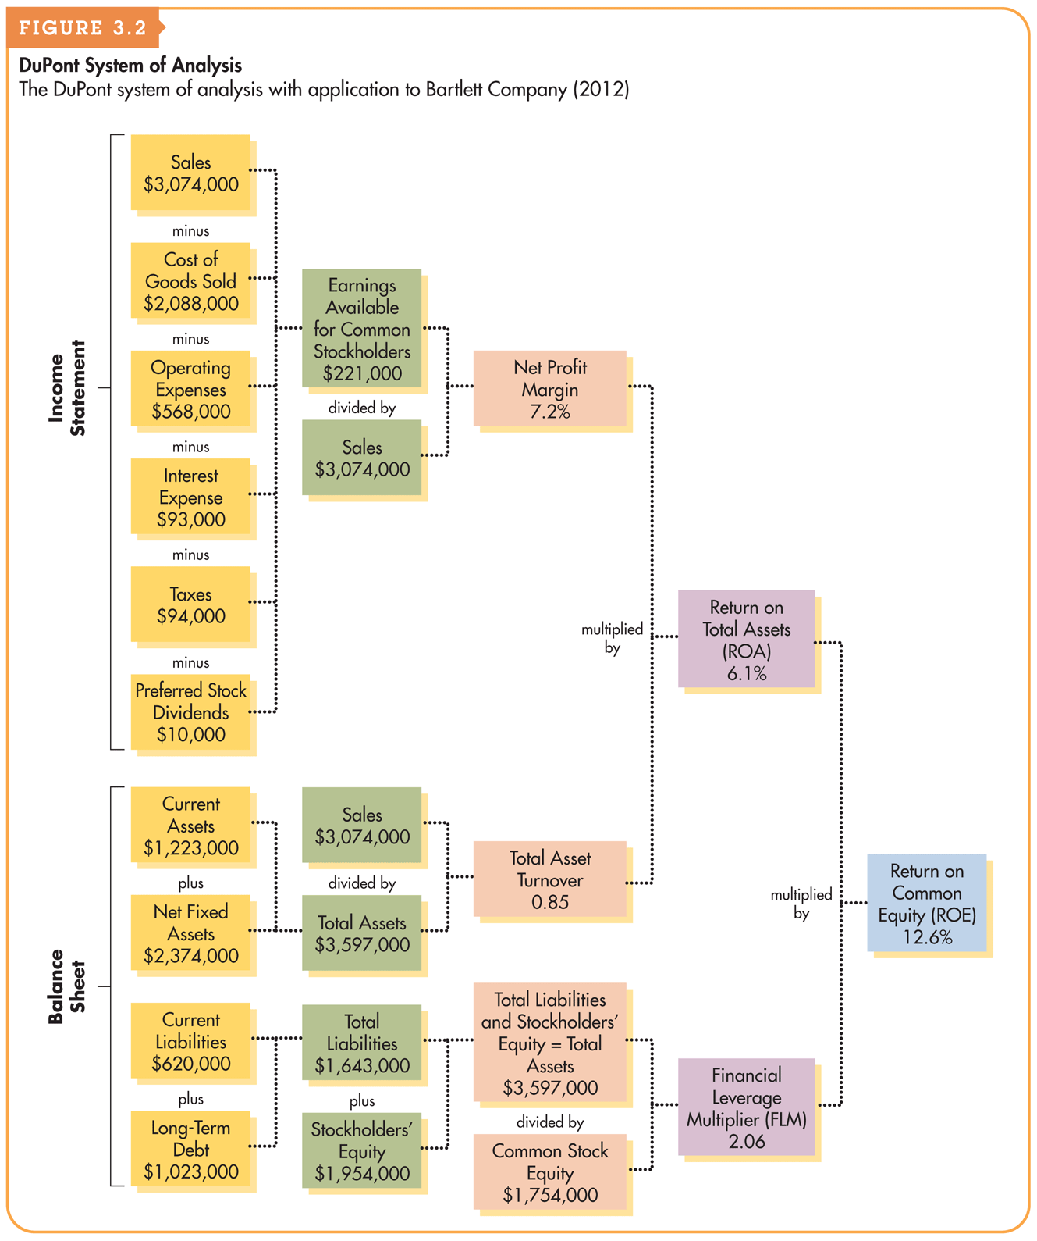
Figure 3.2 DuPont System of Analysis

Slide 56
Matter of Fact
Dissecting ROA
Return to Table 3.5 and examine the total asset turnover figures for Dell and Home Depot.
Both firms turn their assets 1.6 times per year.
Dell’s ROA is 4.3%, but Home Depot’s is significantly higher at 6.5%. Why?
The answer lies in the DuPont formula.
Notice that Home Depot’s net profit margin is 4.0% compared to Dell’s 2.7%.

