Slide 1
Financial Institutions & Markets
Firms that require funds from external sources can obtain them in three ways:
through a financial institution
through financial markets
through private placements

Slide 2
Financial Institutions & Markets: Financial Institutions
Financial institutions are intermediaries that channel the savings of individuals, businesses, and governments into loans or investments.
The key suppliers and demanders of funds are individuals, businesses, and governments.
In general, individuals are net suppliers of funds, while businesses and governments are net demanders of funds.

Slide 3
Commercial Banks, Investment Banks, and the Shadow Banking System
Commercial banks are institutions that provide savers with a secure place to invest their funds and that offer loans to individual and business borrowers.
Investment banks are institutions that assist companies in raising capital, advise firms on major transactions such as mergers or financial restructurings, and engage in trading and market making activities.

Slide 4
Commercial Banks, Investment Banks, and the Shadow Banking System (cont.)
The Glass-Steagall Act was an act of Congress in 1933 that created the federal deposit insurance program and separated the activities of commercial and investment banks.
Repealed in the late 1990s.
The shadow banking system describes a group of institutions that engage in lending activities, much like traditional banks, but these institutions do not accept deposits and are therefore not subject to the same regulations as traditional banks.

Slide 5
Financial Institutions & Markets: Financial Markets
Financial markets are forums in which suppliers of funds and demanders of funds can transact business directly.
Transactions in short term marketable securities take place in the money market while transactions in long-term securities take place in the capital market.
A private placement involves the sale of a new security directly to an investor or group of investors.
Most firms, however, raise money through a public offering of securities, which is the sale of either bonds or stocks to the general public.

Slide 6
Financial Institutions & Markets: Financial Markets (cont.)
The primary market is the financial market in which securities are initially issued; the only market in which the issuer is directly involved in the transaction.
Secondary markets are financial markets in which preowned securities (those that are not new issues) are traded.

Slide 7
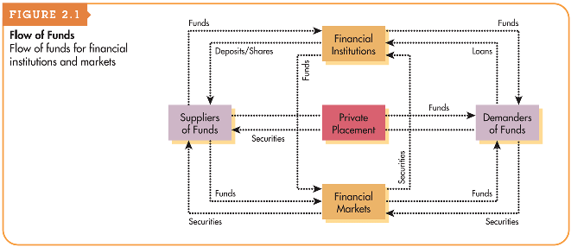
Figure 2.1 Flow of Funds

Slide 8
The Money Market
The money market is created by a financial relationship between suppliers and demanders of short-term funds.
Most money market transactions are made in marketable securities which are short-term debt instruments, such as U.S. Treasury bills, commercial paper, and negotiable certificates of deposit issued by government, business, and financial institutions, respectively.
Investors generally consider marketable securities to be among the least risky investments available.

Slide 9
The Money Market (cont.)
The international equivalent of the domestic (U.S.) money market is the Eurocurrency market.
The Eurocurrency market is a market for short-term bank deposits denominated in U.S. dollars or other marketable currencies.
The Eurocurrency market has grown rapidly mainly because it is unregulated and because it meets the needs of international borrowers and lenders.

Slide 10
The Capital Market
The capital market is a market that enables suppliers and demanders of long-term funds to make transactions.
The key capital market securities are bonds (long-term debt) and both common and preferred stock (equity, or ownership).
Bonds are long-term debt instruments used by businesses and government to raise large sums of money, generally from a diverse group of lenders.
Common stock are units of ownership interest or equity in a corporation.
Preferred stock is a special form of ownership that has features of both a bond and common stock.

Slide 11
The Capital Market
Lakeview Industries, a major microprocessor manufacturer, has issued a 9 percent coupon interest rate, 20-year bond with a $1,000 par value that pays interest semiannually.
Investors who buy this bond receive the contractual right to $90 annual interest (9% coupon interest rate × $1,000 par value) distributed as $45 at the end of each 6 months (1/2 × $90) for 20 years.
Investors are also entitled to the $1,000 par value at the end of year 20.

Slide 12
Focus on Practice
Berkshire Hathaway – Can Buffett Be Replaced?
Since the early 1980s, Berkshire Hathaway’s Class A common stock price has climbed from $285/share to $304,180/share.
The company is led by Chairman Warren Buffett (87) and Vice-Chairman Charlie Munger (94).
The share price of BRKA has never been split. Why might the company refuse to split its shares to make them more affordable to average investors?

Slide 13
Broker Markets and Dealer Markets
Broker markets are securities exchanges on which the two sides of a transaction, the buyer and seller, are brought together to trade securities.
Trading takes place on centralized trading floors.
Examples include: NYSE, American Stock Exchange

Slide 14
Broker Markets and Dealer Markets (cont.)
Dealer markets are markets in which the buyer and seller are not brought together directly but instead have their orders executed by securities dealers that “make markets” in the given security.
The dealer market has no centralized trading floors. Instead, it is made up of a large number of market makers who are linked together via a mass-telecommunications network.
The Nasdaq market is one example
As compensation for executing orders, market makers make money on the spread (bid price – ask price).

Slide 15
Matter of Fact
NYSE Euronext is the World’s Largest Stock Exchange
NYSE is the largest stock market in the world, as measured by the total market value of securities listed on that market.
NYSE has listed securities worth more than $16 trillion.
Third largest is the London Stock Exchange with securities valued at £4.5 trillion, which is equivalent to $6.06 trillion.

Slide 16
International Capital Markets
In the Eurobond market, corporations and governments typically issue bonds denominated in dollars and sell them to investors located outside the United States.
The foreign bond market is a market for bonds issued by a foreign corporation or government that is denominated in the investor’s home currency and sold in the investor’s home market.
The international equity market allows corporations to sell blocks of shares to investors in a number of different countries simultaneously.

Slide 17
The Role of Capital Markets
From a firm’s perspective, the role of capital markets is to be a liquid market where firms can interact with investors in order to obtain valuable external financing resources.
From investors’ perspectives, the role of capital markets is to be an efficient market that allocates funds to their most productive uses.
An efficient market allocates funds to their most productive uses as a result of competition among wealth-maximizing investors and determines and publicizes prices that are believed to be close to their true value.

Slide 18
The Role of Capital Markets (cont.)
Advocates of behavioral finance, an emerging field that blends ideas from finance and psychology, argue that stock prices and prices of other securities can deviate from their true values for extended periods.
These people point to episodes such as the huge run up and subsequent collapse of the prices of Internet stocks in the late 1990s, or the failure of markets to accurately assess the risk of mortgage-backed securities in the more recent financial crisis, as examples of the principle that stock prices sometimes can be wildly inaccurate measures of value.

Slide 19
Focus on Ethics
The Ethics of Insider Trading
Martha Stewart was convicted of conspiracy, obstruction, and making false statements to federal investigators and served 5 months in jail, 5 months of home confinement, 2 years of probation, and a $30,000 fine.
Laws prohibiting insider trading were established in the United States in the 1930s. These laws are designed to ensure that all investors have access to relevant information on the same terms.
However, many market participants believe that insider trading should be permitted.
If efficiency is the goal of financial markets, is allowing or disallowing insider trading more unethical?
Does allowing insider trading create an ethical dilemma for insiders?

Slide 20
The Financial Crisis: Financial Institutions and Real Estate Finance
Securitization is the process of pooling mortgages or other types of loans and then selling claims or securities against that pool in a secondary market.
Mortgage-backed securities represent claims on the cash flows generated by a pool of mortgages and can be purchased by individual investors, pension funds, mutual funds, or virtually any other investor.
A primary risk associated with mortgage-back securities is that homeowners may not be able to, or may choose not to, repay their loans.

Slide 21
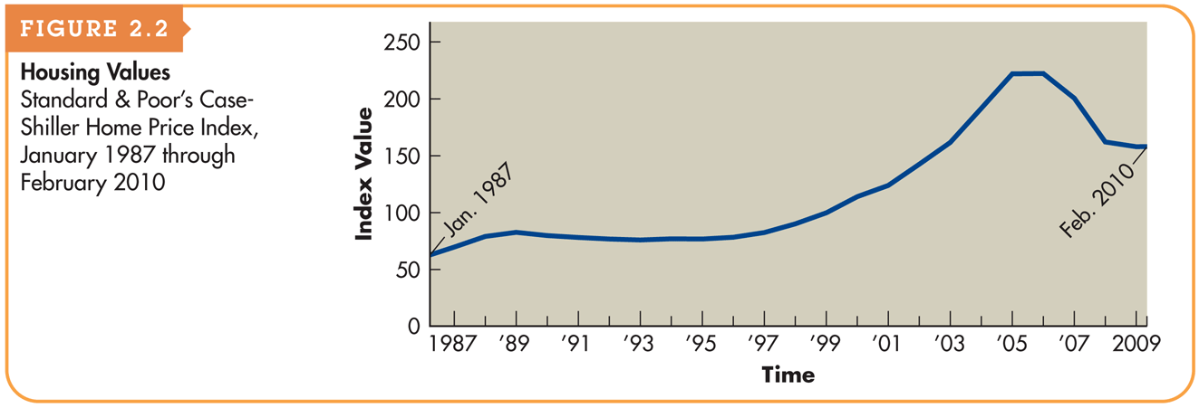
The Financial Crisis: Falling Home Prices and Delinquent Mortgages (Figure 2.2)

Slide 22
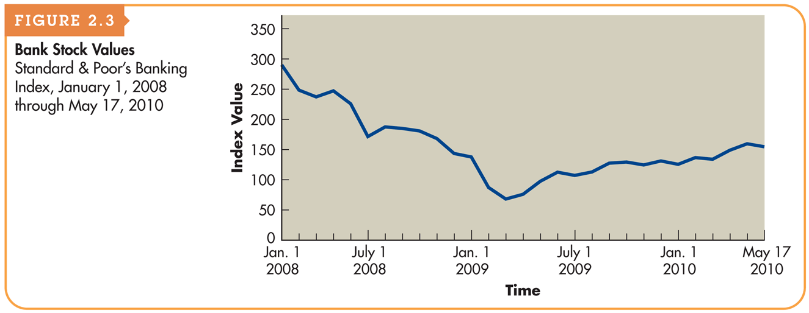
The Financial Crisis: Crisis of Confidence in Banks (Figure 2.3)

Slide 23
The Financial Crisis: Spillover Effects and the Great Recession
As banks came under intense financial pressure in 2008, they tightened their lending standards and dramatically reduced the quantity of loans they made.
Corporations found that they could no longer raise money in the money market, or could only do so at extraordinarily high rates.
As a consequence, businesses began to hoard cash and cut back on expenditures, and economic activity contracted.

Slide 24
Regulation of Financial Institutions and Markets: Regulations Governing Financial Institutions
The Glass-Steagall Act (1933) established the Federal Deposit Insurance Corporation (FDIC) which provides insurance for deposits at banks and monitors banks to ensure their safety and soundness.
The Glass-Steagall Act also prohibited institutions that took deposits from engaging in activities such as securities underwriting and trading, thereby effectively separating commercial banks from investment banks.

Slide 25
Regulation of Financial Institutions and Markets: Regulations Governing Financial Institutions
The Gramm-Leach-Bliley Act (1999) allows business combinations (e.g. mergers) between commercial banks, investment banks, and insurance companies, and thus permits these institutions to compete in markets that prior regulations prohibited them from entering.
Some leaders have argued that Congress should reenact Glass-Steagall, which would effectively mandate the breakup of large financial conglomerates.
Others have proposed the implementation of new regulations, particularly on the large financial institutions that received the most assistance from the government during the financial crisis.

Slide 26
Regulation of Financial Institutions and Markets: Regulations Governing Financial Markets
The Securities Act of 1933 regulates the sale of securities to the public via the primary market.
Requires sellers of new securities to provide extensive disclosures to the potential buyers of those securities.
The Securities Exchange Act of 1934 regulates the trading of securities such as stocks and bonds in the secondary market.
Created the Securities Exchange Commission, which is the primary government agency responsible for enforcing federal securities laws.
Requires ongoing disclosure by companies whose securities trade in secondary markets (e.g., 10-Q, 10-K).
Imposes limits on the extent to which “insiders” can trade in their firm’s securities.

Slide 27
Business Taxes
Both individuals and businesses must pay taxes on income.
The income of sole proprietorships and partnerships is taxed as the income of the individual owners, whereas corporate income is subject to corporate taxes.
Both individuals and businesses can earn two types of income—ordinary income and capital gains income.
Under current law, tax treatment of ordinary income and capital gains income change frequently due frequently changing tax laws.

Slide 28
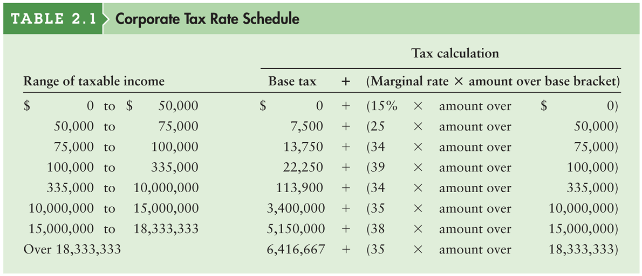
Table 2.1 Corporate Tax Rate Schedule

Slide 29
Business Taxes: Ordinary Income
Ordinary income is earned through the sale of a firm’s goods or services and is taxed at the rates depicted in Table 2.1 on the previous slide.
Example
Weber Manufacturing Inc. has before-tax earnings of $250,000.
Tax = $22,500 + [0.39 × ($250,000 – $100,000)]
Tax = $22,500 + (0.39 × $150,000)
Tax = $22,500 + $58,500 = $80,750

Slide 30
Business Taxation: Marginal versus Average Tax Rates
A firm’s marginal tax rate represents the rate at which additional income is taxed.
The average tax rate is the firm’s taxes divided by taxable income.
Example
What are Webster Manufacturing’s marginal and average tax rates?
Marginal Tax Rate = 39%
Average Tax Rate = $80,750/$250,000 = 32.3%

Slide 31
Business Taxation: Interest and Dividend Income
For corporations only, 70% of all dividend income received from an investment in the stock of another corporation in which the firm has less than 20% ownership is excluded from taxation.
This exclusion moderates the effect of double taxation, which occurs when after-tax corporate earnings are distributed as cash dividends to stockholders, who then must pay personal taxes on the dividend amount.
Unlike dividend income, all interest income received is fully taxed.

Slide 32
Business Taxation: Tax-Deductible Expenses
In calculating taxes, corporations may deduct operating expenses and interest expense but not dividends paid.
This creates a built-in tax advantage for using debt financing as the following example will demonstrate.
Example
Two companies, Debt Co. and No Debt Co., both expect in the coming year to have EBIT of $200,000. During the year, Debt Co. will have to pay $30,000 in interest expenses. No Debt Co. has no debt and will not pay interest expenses.

Slide 33
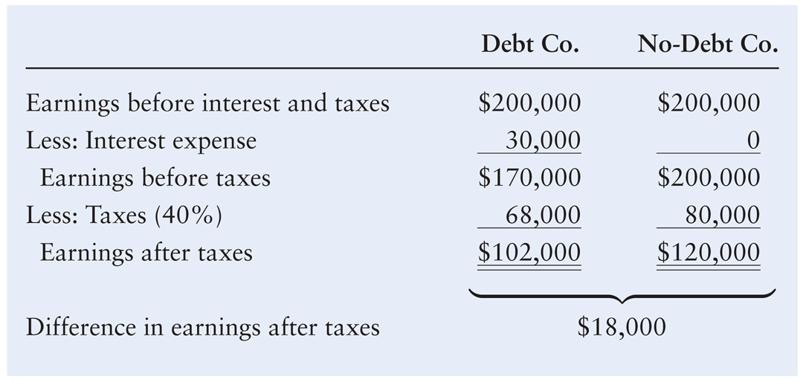
Business Taxation: Tax-Deductible Expenses (cont.)

Slide 34
Business Taxation: Tax-Deductible Expenses (cont.)
As the example shows, the use of debt financing can increase cash flow and decrease taxes paid.
The tax deductibility of interest and other certain expenses reduces their actual (after-tax) cost to the profitable firm.
It is the non-deductibility of dividends paid that results in double taxation under the corporate form of organization.

Slide 35
Business Taxation: Capital Gains
A capital gain is the amount by which the sale price of an asset exceeds the asset’s purchase price.
For corporations, capital gains are added to ordinary income and taxed like ordinary income at the firm’s marginal tax rate.
Example
Ross Company has just sold for $150,000 and asset that was purchased 2 years ago for $125,000. Because the asset was sold for more than its initial purchase price, there is a capital gain of $25,000 ($150,000 - $125,000).

Slide 36
Integrative Case: Merit Enterprise Corp.
Option 1 – Merit could approach JPMorgan Chase, a bank that had served Merit well for many years with seasonal credit lines as well as medium-term loans. Lehn believed that JPMorgan was unlikely to make a $4 billion loan to Merit on its own, but it could probably gather a group of banks together to make a loan of this magnitude. However, the banks would undoubtedly demand that Merit limit further borrowing and provide JPMorgan with periodic financial disclosures so that they could monitor Merit’s financial condition as it expanded its operations.

Slide 37
Integrative Case: Merit Enterprise Corp.
Option 2 – Merit could convert to public ownership, issuing stock to the public in the primary market. With Merit’s excellent financial performance in recent years, Sara thought that its stock could command a high price in the market and that many investors would want to participate in any stock offering that Merit conducted.

Slide 38
Integrative Case: Merit Enterprise Corp.
Discuss the pros and cons of option 1, and prioritize your thoughts. What are the most positive aspects of this option, and what are the biggest drawbacks?
Do the same for option 2.
Which option do you think Sara should recommend to the board and why?

