Slide 1
Making Capital Investment Decisions

Slide 2
Key Concepts and Skills
Understand how to determine the relevant cash flows for various types of proposed investments
Be able to compute depreciation expense for tax purposes
Understand the various methods for computing operating cash flow

Slide 3
Chapter Outline
Project Cash Flows: A First Look
Incremental Cash Flows
Pro Forma Financial Statements and Project Cash Flows
More on Project Cash Flow
Alternative Definitions of Operating Cash Flow
Some Special Cases of Cash Flow Analysis

Slide 4
Relevant Cash Flows
The cash flows that should be included in a capital budgeting analysis are those that will only occur if the project is accepted
These cash flows are called incremental cash flows
The stand-alone principle allows us to analyze each project in isolation from the firm simply by focusing on incremental cash flows

Slide 5
Asking the Right Question
You should always ask yourself “Will this cash flow occur ONLY if we accept the project?”
  If the answer is “yes”, it should be included in the analysis because it is incremental
  If the answer is “no”, it should not be included in the analysis because it will occur anyway
  If the answer is “part of it”, then we should include the part that occurs because of the project

Slide 6
Common Types of Cash Flows
Sunk costs – costs that have accrued in the past
Opportunity costs – costs of lost options
Side effects
  Positive side effects – benefits to other projects
  Negative side effects – costs to other projects
Changes in net working capital
Financing costs
Taxes
Notes:
With each of these types of cash flows, you should ask the class the question on the previous slide so that they can start to determine if the cash flows are relevant.
Sunk costs – our government provides ample examples of inappropriately including sunk costs in their capital allocation decisions.
Opportunity costs – the classic example of an opportunity cost is the use of land or plant that is already owned. It is important to point out that this is not “free.” At the very least we could sell the land; consequently if we choose to use it, we cost ourselves the selling price of the asset.
A good example of a positive side effect is when you will establish a new distribution system with this project that can be used for existing or future projects. The benefit provided to those projects needs to be considered.
The most common negative side effect is erosion or cannibalism, where the introduction of a new product will reduce the sales of existing, similar products. A good real-world example is McDonald’s introduction of the Arch Deluxe sandwich. Instead of generating all new sales, it primarily reduced sales in the Big Mac and the Quarter Pounder.
It is important to consider changes in NWC. We need to remember that operating cash flow derived from the income statement assumes all sales are cash sales and that the COGS was actually paid in cash during that period. By looking at changes in NWC specifically, we can adjust for the difference in cash flow that results from accounting conventions. Most projects will require an increase in NWC initially as we build inventory and receivables. Then we recover NWC at the end of the project.
We do not include financing costs. Students often have difficulty understanding why when it appears that we will only raise capital if we take the project. It is important to point out that because of economies of scale, companies generally do not finance individual projects. Instead, they finance the entire portfolio of projects at one time. The other reason has to do with maintaining a target capital structure over time, but not necessarily each year. Finally, financing cost is included in the required return, thus including the financing-related cash flows would be double counting.
Taxes will change as the firm’s taxable income changes. Consequently, we have to consider cash flows on an after-tax basis.

Slide 7
Pro Forma Statements and Cash Flow
Capital budgeting relies heavily on pro forma accounting statements, particularly income statements
Computing cash flows – refresher
  Operating Cash Flow (OCF) = EBIT + depreciation – taxes
  OCF = Net income + depreciation when there is no interest expense
  OCF = After Tax Cost savings + Depreciation Tax Shield { Cost Savings*(1-T)+ Depreciation*T}
  Cash Flow From Assets (CFFA) = OCF – net capital spending (NCS) – changes in NWC
Notes:
Operating cash flow – students often have to go back to the income statement to see that the two definitions of operating cash flow are equivalent when there is no interest expense.

Slide 8
Table 10.1 Pro Forma Income Statement
Sales (50,000 units at $4.00/unit) | $200,000
Variable Costs ($2.50/unit) | 125,000
Gross profit | $ 75,000
Fixed costs | 12,000
Depreciation ($90,000 / 3) | 30,000
EBIT | $ 33,000
Taxes (34%) | 11,220
Net Income | $ 21,780

Slide 9
Table 10.2 Projected Capital Requirements
 | Year
 | 0 | 1 | 2 | 3
NWC | $20,000 | $20,000 | $20,000 | $20,000
NFA | 90,000 | 60,000 | 30,000 | 0
Total | $110,000 | $80,000 | $50,000 | $20,000
Notes:
Ask the students why net fixed assets is decreasing each year. It is important that they understand why this is happening when they go to compute the net capital spending in the next slide.

Slide 10
Table 10.5 Projected Total Cash Flows
 | Year
 | 0 | 1 | 2 | 3
OCF |  | $51,780 | $51,780 | $51,780
Change in NWC | -$20,000 |  |  | 20,000
NCS | -$90,000
CFFA | -$110,000 | $51,780 | $51,780 | $71,780
Notes:
OCF = EBIT + depreciation – taxes = 33,000 + 30,000 – 11,220 = 51,780; or
OCF = NI + depreciation = 21,780 + 30,000 = 51,780
Note that in the Table in the book, the negative signs have already been carried throughout the table so that the columns can just be added. Ultimately, students seem to do better with this format even though the CFFA equation says to subtract the changes in NWC and net capital spending.
Change in NWC = We have a net investment in NWC in year 0 of 20,000; we get the investment back at the end of the project when we sell our inventory, collect on our receivables and pay off our payables. Students often forget that we get the investment back at the end.
Capital Spending – remember that Net capital spending = change in net fixed assets + depreciation. So in year one NCS = (60,000 – 90,000) + 30,000 = 0; The same is true for the other years.

Slide 11
Making The Decision
Now that we have the cash flows, we can apply the techniques that we learned in chapter 9
Compute NPV and IRR
  NPV = 10,648
  IRR = 25.8%
Should we accept or reject the project?
Notes:
You can also use the formulas to compute NPV and IRR; just remember that the IRR computation is trial and error.
Click on the excel icon to go to an embedded spreadsheet that illustrates how the pro formas and cash flows can be set-up. It also computes the NPV and IRR.

Slide 12
More on NWC
Why do we have to consider changes in NWC separately?
  GAAP requires that sales be recorded on the income statement when made, not when cash is received
  GAAP also requires that we record cost of goods sold when the corresponding sales are made, whether we have actually paid our suppliers yet
  Finally, we have to buy inventory to support sales although we haven’t collected cash yet
Notes:
The first two items mean that our operating cash flow does not include the impact of accounts receivable and accounts payable on cash flow. The third item is very much like the purchase of fixed assets. We have to buy the assets (have the cash outflow) before we can generate sales.
By looking at changes in NWC, we can incorporate the increased investment in receivables and inventory that are necessary to support additional sales. Because we look at changes in NWC, and not just current assets, we also incorporate the increase in our payable accounts that partially pays for the investment in inventory and receivables.

Slide 13
Depreciation
The depreciation expense used for capital budgeting should be the depreciation schedule required by the IRS for tax purposes
Depreciation itself is a non-cash expense; consequently, it is only relevant because it affects taxes
Depreciation tax shield = DT
  D = depreciation expense
  T = marginal tax rate

Slide 14
Computing Depreciation
Straight-line depreciation
  D = (Initial cost – salvage) / number of years
  Very few assets are depreciated straight-line for tax purposes
MACRS
  Need to know which asset class is appropriate for tax purposes
  Multiply percentage given in table by the initial cost
  Depreciate to zero
  Mid-year convention
Notes:
The MACRS percentages are given in Table 10.7 on page 313.

Slide 15
After-tax Salvage
If the salvage value is different from the book value of the asset, then there is a tax effect
Book value = Initial cost – Accumulated depreciation
After-tax salvage = Salvage – T(Salvage – Book Value)

Slide 16
Example: Depreciation and After-tax Salvage
You purchase equipment for $100,000 and it costs $10,000 to have it delivered and installed. Based on past information, you believe that you can sell the equipment for $17,000 when you are done with it in 6 years. The company’s marginal tax rate is 40%. What is the depreciation expense each year and the after-tax salvage in year 6 for each of the following situations?

Slide 17
Example: Straight-line Depreciation
Suppose the appropriate depreciation schedule is straight-line
  D = (110,000 – 17,000) / 6 = 15,500 every year for 6 years
  BV in year 6 = 110,000 – 6(15,500) = 17,000
  After-tax salvage = 17,000 - .4(17,000 – 17,000) = 17,000

Slide 18
Example: Three-year MACRS
Year | MACRS percent | D
1 | .3333 | .3333(110,000) = 36,663
2 | .4444 | .4444(110,000) = 48,884
3 | .1482 | .1482(110,000) = 16,302
4 | .0741 | .0741(110,000) = 8,151
BV in year 6 = 110,000 – 36,663 – 48,884 – 16,302 – 8,151 = 0
After-tax salvage = 17,000 - .4(17,000 – 0) = $10,200
Notes:
Note that with MACRS you do not subtract the expected salvage from the initial cost.
Also note that the MACRS % is multiplied by the initial cost every year. For some reason, students want to multiply by the book value.

Slide 19
Example: Five-Year MACRS
Year | MACRS Percent | D
1 | .1429 | .1429(110,000) = 15,719
2 | .2449 | .2449(110,000) = 26,939
3 | .1749 | .1749(110,000) = 19,239
4 | .1249 | .1249(110,000) = 13,739
5 | .0893 | .0893(110,000) = 9,823
6 | .0893 | .0893(110,000) = 9,823
BV in year 6 = 110,000 – 15,719 – 26,939 – 19,239 – 13,739 – 9,823 – 9,823 = 14,718
After-tax salvage = 17,000 - .4(17,000 – 14,718) = 16,087.20

Slide 20
Example: Replacement Problem
Original Machine
  Initial cost = 100,000
  Annual depreciation = 9000
  Purchased 5 years ago
  Book Value = 55,000
  Salvage today = 65,000
  Salvage in 5 years = 10,000
New Machine
  Initial cost = 150,000
  5-year life
  Salvage in 5 years = 0
  Cost savings = 50,000 per year
  3-year MACRS depreciation
Required return = 10%
Tax rate = 40%

Slide 21
Replacement Problem – Computing Cash Flows
Remember that we are interested in incremental cash flows
If we buy the new machine, then we will sell the old machine
What are the cash flow consequences of selling the old machine today instead of in 5 years?

Slide 22
Replacement Problem – Pro Forma Income Statements
Year | 1 | 2 | 3 | 4 | 5
Cost Savings | 50,000 | 50,000 | 50,000 | 50,000 | 50,000
Depr.
New | 49,995 | 66,660 | 22,230 | 11,115 | 0
Old | 9,000 | 9,000 | 9,000 | 9,000 | 9,000
Increm. | 40,995 | 55,660 | 13,230 | 2,115 | (9,000)
EBIT | 9,005 | (7,660) | 36,770 | 47,885 | 59,000
Taxes | 3,602 | (3,064) | 14,708 | 19,154 | 23,600
NI | 5,403 | (4,596) | 22,062 | 28,731 | 35,400

Slide 23
Replacement Problem – Incremental Net Capital Spending
Year 0
  Cost of new machine = 150,000 (outflow)
  After-tax salvage on old machine = 65,000 - .4(65,000 – 55,000) = 61,000 (inflow)
  Incremental net capital spending = 150,000 – 61,000 = 89,000 (outflow)
Year 5
  After-tax salvage on old machine = 10,000 - .4(10,000 – 10,000) = 10,000 (outflow because we no longer receive this)
Notes:
The year 5 cash flow is the most difficult for students to grasp. It is important to point out that we are looking for ALL changes in cash flow associated with selling the machine today instead of in 5 years. If we do not sell the machine today, then we will have after-tax salvage of 10,000 in 5 years. Since we do sell the machine today, we LOSE the 10,000 cash flow in 5 years.

Slide 24
Replacement Problem – Cash Flow From Assets
Year | 0 | 1 | 2 | 3 | 4 | 5
OCF |  | 46,398 | 53,064 | 35,292 | 30,846 | 26,400
NCS | -89,000 |  |  |  |  | -10,000
Δ In NWC | 0 |  |  |  |  | 0
CFFA | -89,000 | 46,398 | 53,064 | 35,292 | 30,846 | 16,400
Notes:
The negative signs in the CFFA equation were once again carried through the table. That way outflows are in the table as negative and inflows are positive.

Slide 25
Replacement Problem – Analyzing the Cash Flows
Now that we have the cash flows, we can compute the NPV and IRR
  Compute NPV = 54,801
  Compute IRR = 36.28%
Should the company replace the equipment?

Slide 26
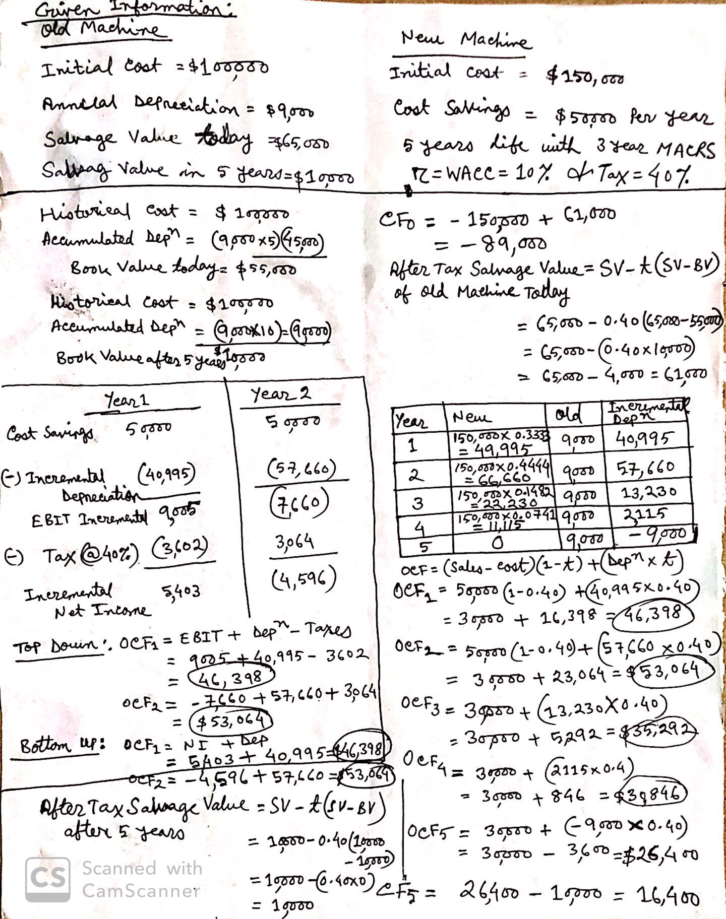

Slide 27
Other Methods for Computing OCF
Bottom-Up Approach
  Works only when there is no interest expense
  OCF = NI + depreciation
Top-Down Approach
  OCF = Sales – Costs – Taxes
  Don’t subtract non-cash deductions
Tax Shield Approach
  OCF = (Sales – Costs)(1 – T) + Depreciation*T

Slide 28
Example: Cost Cutting
Your company is considering a new computer system that will initially cost $1 million. It will save $300,000 a year in inventory and receivables management costs. The system is expected to last for five years and will be depreciated using 3-year MACRS. The system is expected to have a salvage value of $50,000 at the end of year 5. There is no impact on net working capital. The marginal tax rate is 40%. The required return is 8%.
Click on the Excel icon to work through the example
Notes:
There are two worksheets. The first allows you to enter the information and work the example during class. The second provides the solutions. You may go directly to this one if you do not wish to show the students how to set up the spreadsheet during class time.

Slide 29
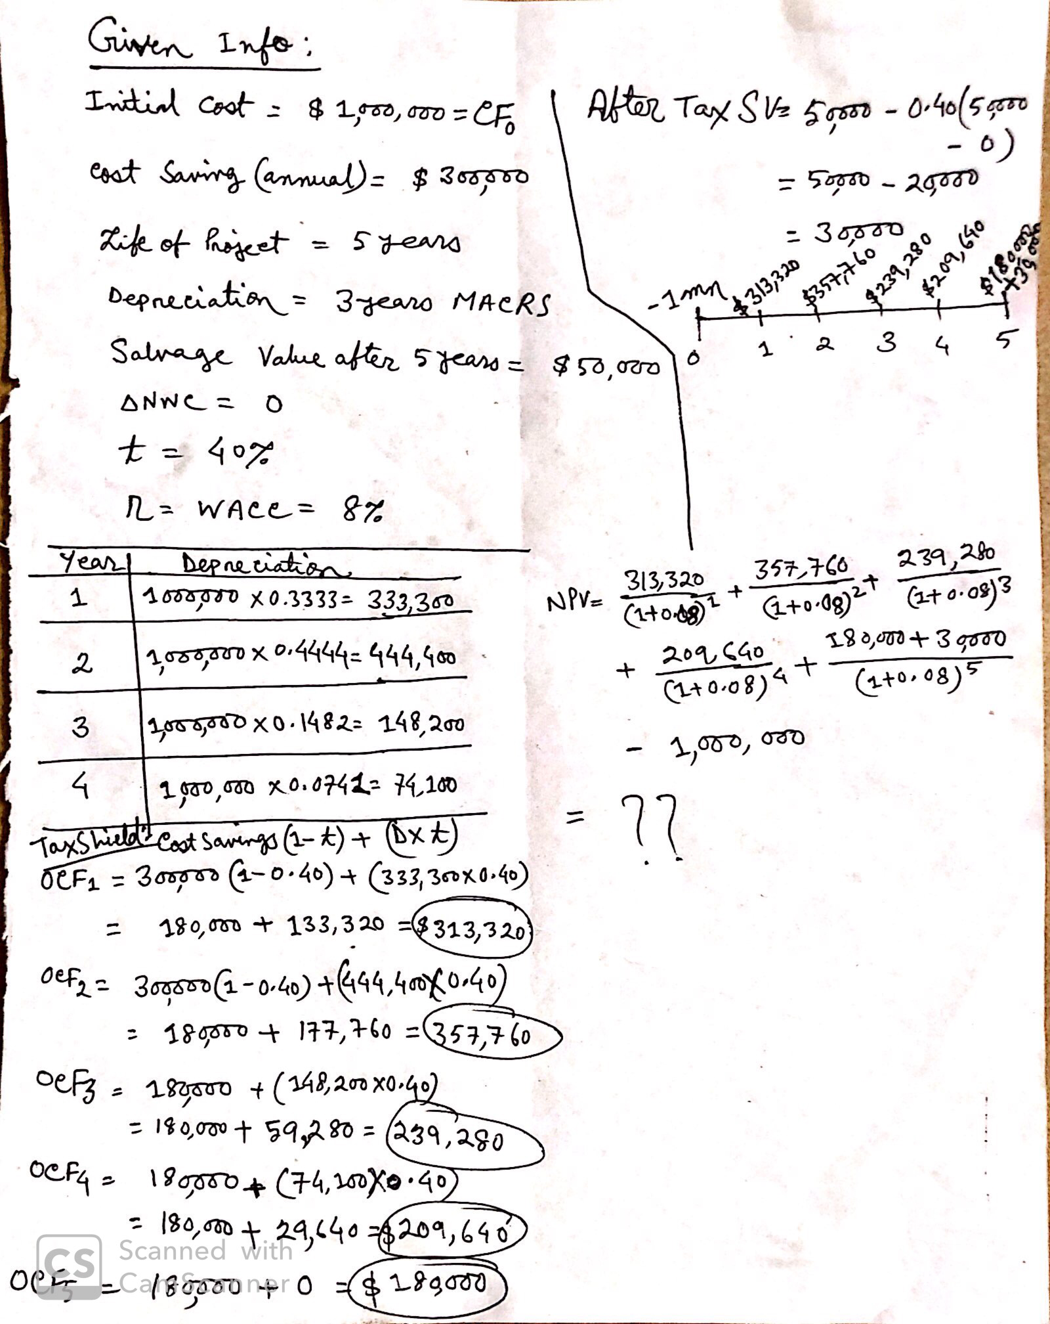

Slide 30
Quick Quiz
How do we determine if cash flows are relevant to the capital budgeting decision?
What are the different methods for computing operating cash flow and when are they important?

Slide 31
End of Chapter

Slide 32
Comprehensive Problem
A $1,000,000 investment is depreciated using a seven-year MACRS class life. It requires $150,000 in additional inventory, and will increase accounts payable by $50,000. It will generate $400,000 in revenue and $150,000 in cash expenses annually, and the tax rate is 40%. What is the incremental cash flow in years 0, 1, 7, and 8?
Notes:
Annual depreciation expense:
Year 1: .1429 x $1million = $142,900
Year 7: .0893 x $1million = $89,300
Year 8: .0445 x $1million = $44,500
Time 0 cash flow = -$1million investment – ($100,000 - $50,000) NWC = -$1,050,000
Time 7 cash flow = ($400,000 - $150,000) x (1 - .4) + (.4 x $89,300) = $185,720
Time 8 cash flow = ($400,000 - $150,000) x (1 - .4) + (.4 x $44,500) + $100,000 NWC = $267,800

