Slide 1
Chapter 7
Managing Supplier Financing

Slide 2
Use of Supplier Financing
Accounts Payable:
Refers to buyers use of supplier financing to purchase inputs needed to produce goods.
Trade credit from supplier provide spontaneously generated source of financing
Open Account
A common credit arrangement between supplier and buyer
Net Terms: Supplier offer no discount but provide time for the buyer to pay. i.e.: net 30
Discount Terms: Offering a cash discount for early payment. i.e.: 2/10, net 30

Slide 3
Types of Purchase Terms
Cash in advance
Cash on delivery
Cash term
Prox
Seasonal dating
Consignment

Slide 4
Cash In Advance (CIA)/Cash Before Delivery (CBD)
Safest form of payment
Payment must be received before the order is shipped.
When the seller dose not want to take risk of buyer not paying
Firms using CIA don’t need to run credit administration or incur bad debt.

Slide 5
Cash On Delivery
Material shipped to the buyer, cash must be paid upon delivery.
Guaranteed payment
Cost of running credit admin dept. and default risk is minimized

Slide 6
Cash terms/ payable upon receipt of invoice
Seller incur admin costs in monitoring payment and runs the risk of bad debt and delayed payments

Slide 7
Prox
With Prox (proximate) term, all invoices dated prior to a predefined cutoff period are payable by a specified date the following month.
The term 2/10, prox net 30 means the same as ‘2/10, net 30’ except that the 10 and 30 refer to the 10 and 30 of the next month.

Slide 8
Seasonal Dating
For highly seasonal items
Payment is due after the end of the buyer’s selling season.
2/10, net 30 dating 90 means that the time will start after 90 days from the date of invoice.
Seller is able to smooth production without excessive inventory buildup.

Slide 9
Consignment terms
Arrangement where a retailer obtains an inventory item without obligation.
The seller ships the goods to the buyer who has no obligation to pay until the goods have been sold or used.
If the items are not sold, the retailer can return the item without any penalty
Cash flow may be delayed significantly
Seller is somehow protected by retaining the title of the goods

Slide 10
Payables Decisions and the Cash Flow Timeline
Time ==>
Purchase Cash Credit
Date Discount Date Period

Slide 11
Basic Principles
Never pay early, pay on the last day of:
the discount period, or
the credit period
Take a cash discount when:
Annualized discount rate > Annualized borrowing cost (opportunity rate)
Stretch only as a last resort, not as a policy

Slide 12
Payment Decision Model
When days delayed ≤ discount period (Taking discount)
When days delayed > discount period (Credit period)
When days delayed > credit period (Stretching)

Slide 13
When Days Delayed ≤ Discount Period
PV = - _ IP x (1-d)_____
[1 + (DD)×(k/365)]
where,
PV: Present Value of the Purchase
IP: Invoice Price
DD: Days until payment is made
d: Discount percentage received if paid during discount period
k: Annual opportunity cost

Slide 14
When Days Delayed > Discount Period
PV = - IP_________
[1 + (DD)×(k/365)]
Where,
IP = Invoice Price
DD = Days Delayed
k = Cost of capital

Slide 15
When Days Delayed > Credit Period
IP x (1+f) PV = - ------------------------------- [1+ (DD)×(k/365)]
Where,
IP = Invoice Price
f = Late fee
DD = Days Delayed
k = Cost of capital

Slide 16
Take or Leave a Discount
K_{TC} = d__ × __365 _
(1-d) (CP-DP)
Here,
k_{TC}: Annualized cost of trade credit
d: Discount percentage taken if paid before discount period expire
DP: Days until discount period ends
CP: Days until trade credit period ends

Slide 17
Monitor the Use of Supplier Financing
A payment policy can be formulated once buyer receives trade credit terms from supplier.
The next step is to monitor the execution of the policy to reduce likelihood of losing cash discount or paying late.
The Balance Fraction Method
Days Payable Outstanding

Slide 18
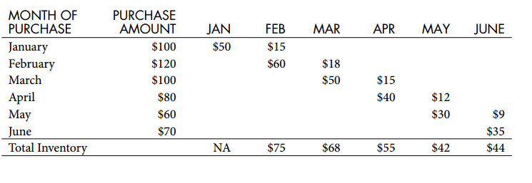
Balance Fraction Approach

Slide 19
Balance Fraction Approach (Cont.)

Slide 20
Monitoring the A/C Payable balance

Slide 21
Monitoring the A/C Payable balance (Cont.)
 | January | February | March | April | May | June
Purchases | 100 | 120 | 100 | 80 | 60 | 70
Ending Payables |  |  | 68 | 55 | 42 | 44
Average Daily Purchases (quarterly) |  |  | 3.56 | 3.33 | 2.67 | 2.33
DPO |  |  | 19.1 | 16.5 | 15.8 | 18.9

Slide 22
Accruals
Definition
an expense that has been incurred but has not yet been paid
Two basic types
accrued wages and salaries
accrued interest and taxes

